Slide 1
GROUNDSWELL: DANCE AS A FORCE FOR SOCIAL CHANGE
A Pathway to Understanding and Healing:
Exclusivity and Racism in Dance
DELAWARE DANCE EDUCATION ORGANIZATION IN COLLABORATION WITH PARTNERSHIP FOR ARTS AND CULTURE

Slide 2
One Million Truths- Sterling Brown
“I think it’s a centralized way for Black folks to see other people’s stories and for allies who are interested to see that the experiences that their friends have told them about are not a one-off, that it’s not just something that happened in an isolated incident, that these isolated incidents are happening over and over again all over the country. Maybe by having one place where people can go and see, like, ‘oh life for Black people in this country is not the same as it is for me.’ Right, and then there’s a development of empathy and hopefully a wave of support that we can ride right now to make some real change to systemic racism in this country."

Slide 3
How to be an Antiracist by Ibram X. Kendi
" 'Racist' and 'antiracist' are like peelable name tags that are placed and replaced based on what someone is doing or not doing, supporting or expressing in each moment. These are not permanent tattoos. No one becomes a racist or anti-racist. We can only strive to be one or the other. We can unknowingly strive to be racist. We can knowingly strive to be anti-racist. Like fighting an addiction, being an anti-racist requires persistence self-awareness, constant self-criticism, and regular self-examination."

Slide 4
Essential Question: By looking at our belief systems and norms set up in our society and culture:
To what extent does dance in its many forms reflect what is happening in society AND to what extent can dance influence society?
As dancers, how can we create works that address what is happening in society: white privilege, political strife

Slide 5
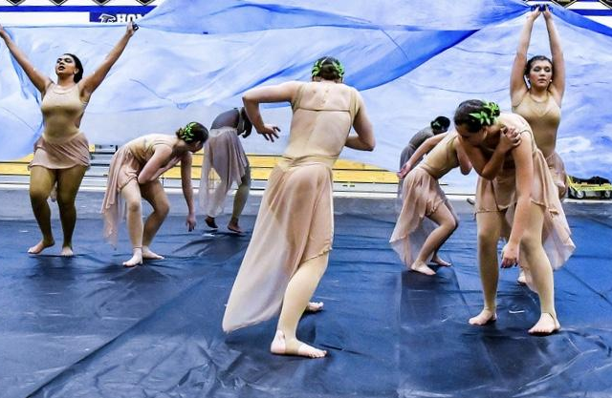
WEBINAR GOAL OR OUTCOMES
What is present in our lives (images)and how we feel about it (imageless)
How can we embrace ourselves, share ourselves, assimilate with others in hopes for transformation into something completely new and different.
Video available in resources

Slide 6
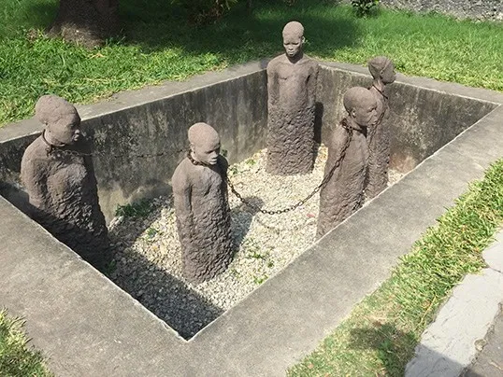
POWER GAMES WE PLAY
Children’s games with winners/losers that are movement based (can open up a discussion about the haves and have nots that promote power issues).
Red rover, red light green light, freeze tag, ….
“Room to Move" is from Interdisciplinary Learning through Dance: 101 Moventures, Overby, Post & Newman (lesson available in the resources).
Discrimination, oppression, and the loss of freedom
Enslaved people crammed in small spaces, Jews during the Holocaust, immigrants in cages, etc….

Slide 7
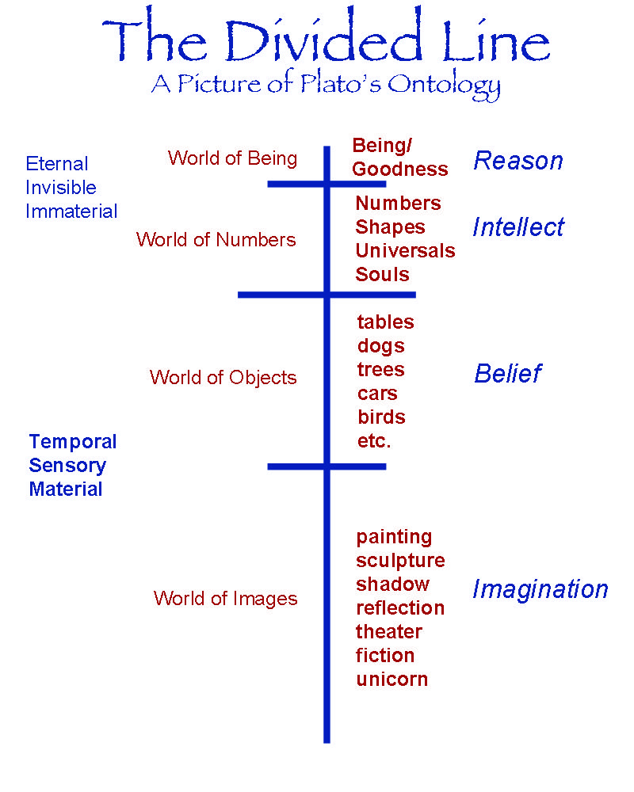
PLATO’S ONTOLOGY
Looking at human behavior historically to uncover how we view what is real versus what is true?
Racism exists, sexism exists, covid exists…
Feelings can be more universal than we think even though they may stem from a different causality.
Changing perceptions to create and fostering empathy.

Slide 8
CYCLE OF JUDGEMENT
Stereotypes
Black Girl Linguistic play. Camille Brown
“NEGOTIATING MY SASS". TEDx Talks
This talk is about the creative process for BLACK GIRL: Linguistic Play and the experience that changed the direction of the process and Ms. Brown's performance life. CAMILLE A. BROWN is a prolific choreographer who has achieved multiple accolades and awards for her daring works.

Slide 9
America’s Racial Future. Arthur Mitchell
No other race in history has been so scientifically separated from their culture and their self esteem as slavery did in this country when they brought Blacks from Africa. And that’s what’s gotta be ...ReBuild...not just the system...it’s us. Arthur Mitchell

Slide 10
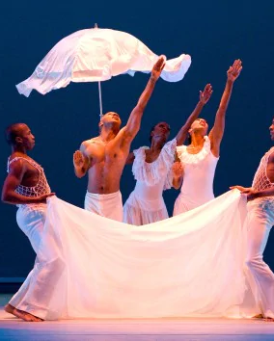
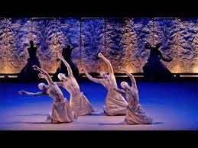
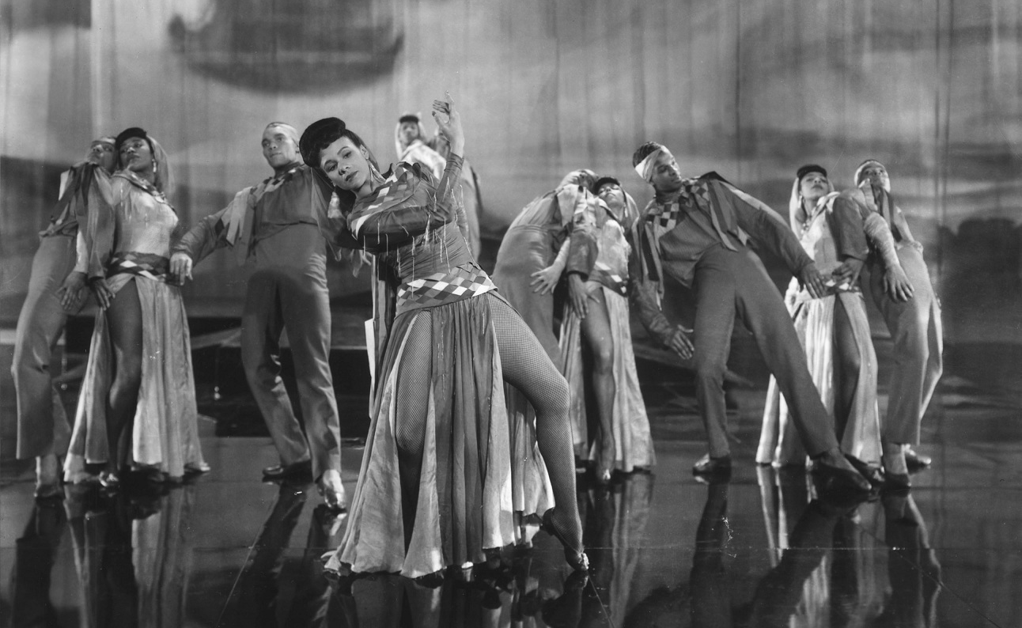
LOOKING BEYOND SKIN COLOR
What does it mean to be human?
Cultural Anthropology: Curt Sachs, Katherine Dunham, Alvin Ailey, Sankai Juku
Movement styles that are embedded in our history tell our stories through time.

Slide 11
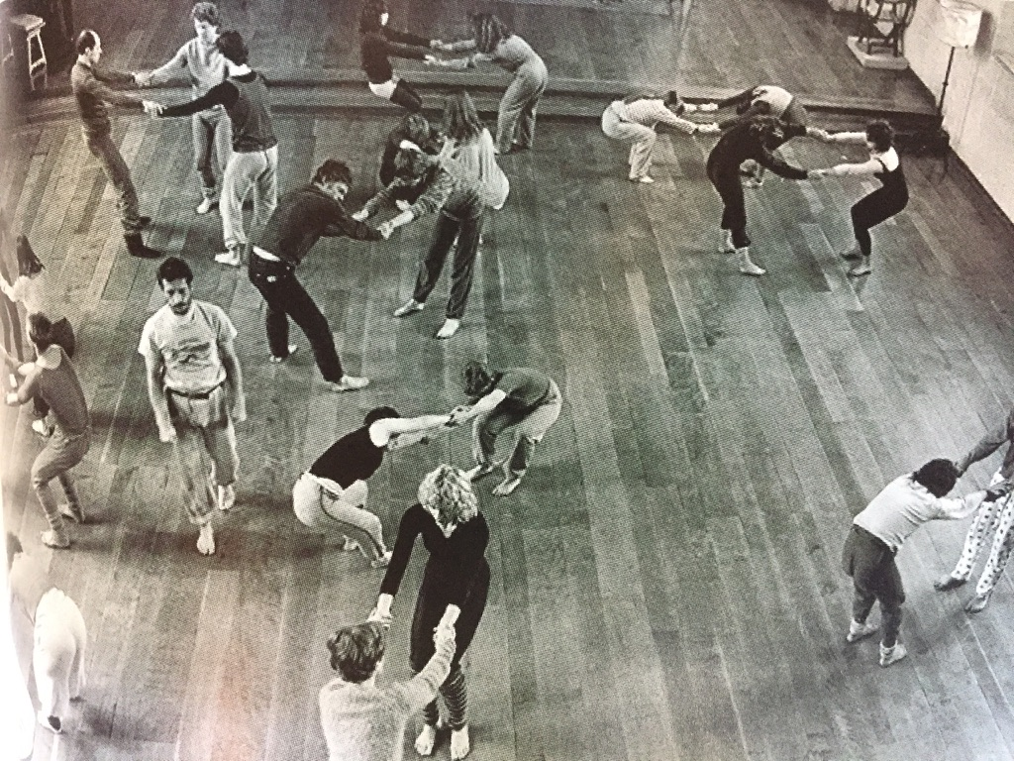
OPPOSITIONAL PARADIGMS
Traditionally:
Nature/Nurture, warrior/ peacemaker, patriarchal/matriarchal, meat eaters/ vegetarians, abled/disabled, have/have nots
Note: There is a huge shift with the two- group paradigm – We can take advantage of this!

Slide 12
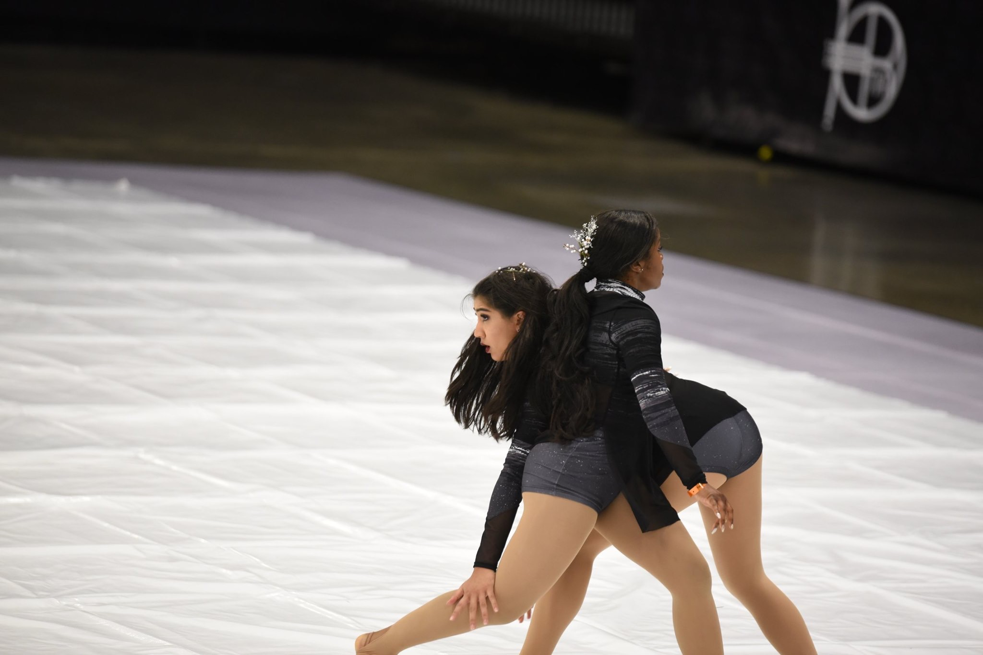
DUO IMPROVISATIONS (POST CO-VID)
Theatre games of YES for dance
Mirroring and opposition, complementing, flocking
Contact improv and weight sharing
Call and response
I’m right – no I’m right…Energy that is expended doing this to show how the aggressor wins out – discussion as to what happens when one of you steps aside (allows discussion of power struggles)

Slide 13
IMPROVISATION/MOVEMENT EXPLORATION Resource idea
Select (3) Words from each of the Lists .....or use your own words
Using shapes, levels, dynamics and rhythm, explore how you can convey these feelings and images through gestures and movement.
Keep the movements simple. You’ll have a chance to change, vary, and combine them when creating your stories.

Slide 14
WORD BANK
Action Reaction Resolution
Refuse Differ ……….. Hostile
Separate Withdraw ……….. Exclude
Distance Cold ………..
Apathetic Indifferent ………..
Resist Discriminate ………..

Slide 15
NEGATIVE AND POSITIVE RESPONSES TO AN INCIDENT/PERSON
REACTION (Negative)
Anger
Lash out
Defy
Avenge
Isolate
Demean
Abuse
Degrade
Subvert
REACTION (Positive)
Curious
Reach–out
Heal
Engage
Inquire
Include
Understand
Empathize

Slide 16
RESOLUTION POSSIBILITIES
CHANGE MODIFY CALL TO ACTION
INCLUSIVITY DIVERSITY ADAPTATION
ACCEPTANCE UNITY POSITIVE DETERMINATION

Slide 17
VIDEO RESOURCES
•DC TapFest.“Glory”#blacklivesmatter
https://www.facebook.com/dctapfest9/videos/183240566351615/?v=183240566351615
•A glimpse in Maleek Washington’s rehearsal during a Dover HS residency, using movements created from improvisdation
https://drive.google.com/file/d/1JmRgfIp3UGbJVhAM6xnRmsW63FHlZRdx/view?usp=sharing

Slide 18
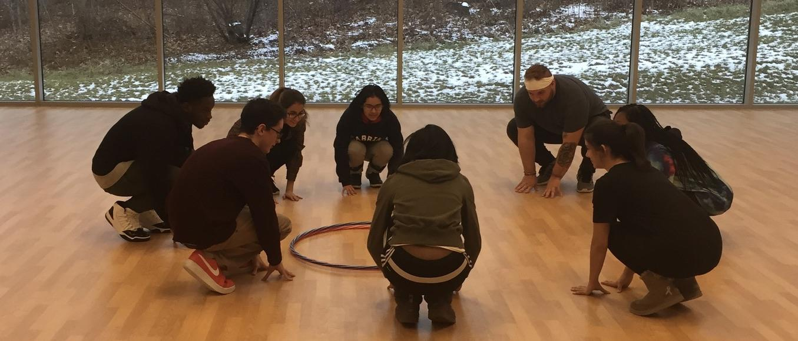
LET’S MOVE
FEEL FREE TO OBSERVE OR PARTICIPATE IN THE IMPROVISATION
SHORT WARM-UP
REACTING TO WORDS

Slide 19
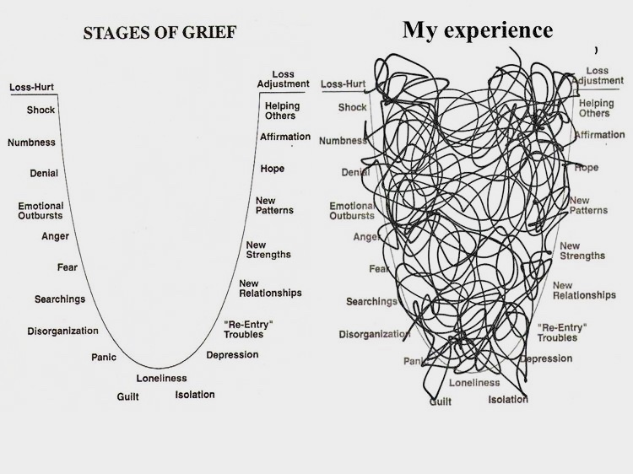
Tonight’s task: Creating our Solo Stories
Write
Create movement – Beg pose-move – ending
Dance
Share
Transform from our essence – video resource
Do what we can control!

Slide 20
BREAK OUT ROOMS: SOLO STORIES
Think back on a time when you were not treated fairly. Perhaps you were threatened, insulted, put down, left out, laughed at, or even attacked.
Briefly write down the story including the images and the feelings attached to the event.
Create a short dance study about the event. (No more than 40 – 45 seconds or about 64 counts).
1
2
3
The story can be more narrative (image) in nature or it can be more abstract (imageless) or both!
Share your dance work with others in the break-out room. Choose one movement from each other and using jigsaw recreate a new phrase that is transformational
Suggested timeline: 10 minute to create the dance, 5 minutes to share, 5 minutes to recreate a new phrase.
4

Slide 21
3 Solos
Stories based on stories: loss, fear, confusion, sadness, running away

Slide 22
3 Short solos with Shared Space – no contact

Slide 23
CLOSURE AND EXTENSION IDEAS Can we as dance educators inform and change societal norms?
Reflection on the process of creation and implementation of the dance study – each group has one participant sharing out,
Focus was on the process of the activity not the actual dance itself as this exercise is ephemeral.
Can we as dance educators inform and change societal norms?
Please put your email address in the chat if you did not register for materials.

Slide 24
ADDITIONAL RESOURCES
TEXT
VIDEO
Maria Tallchief–Osage Native and America’s First Prima Ballerina: Hidden Figures
https://www.youtube.com/watch?v=EcACMHfiTgI
Before #BlackLives Matter: A Timeline (Dance Magazine)
https://www.dancemagazine.com/before-blacklivesmatter-a-timeline-2307047554.html rebelltitem=3#rebelltitem3
Systemic Racism in Dance
http://seattledances.com/2020/06/recognizing-systemic-racism-in-dance/Recognizing
The Universe is US – Joan Warburton-Phibbs
https://www.youtube.com/watch?v=oMXI1HPP7Es&t=328s
5 Stages of Grief – Joan Warburton-Phibbs
https://www.youtube.com/watch?v=Qp_6z3BwTUE&t=133s
Why Telling Our Own Story Is So Powerful for Black Americans by Andrea Collier
https://greatergood.berkeley.edu/article/item/why_telling_our_own_story_is_so_powerful_for_black_americans
African American Almanac: 400 Years of Triumph, Courage and Excellence by
Lean'tin Bracks Ph.D. (Author), Jessie Carney Smith (Foreword)
Room to Move ( see next page)

Slide 25
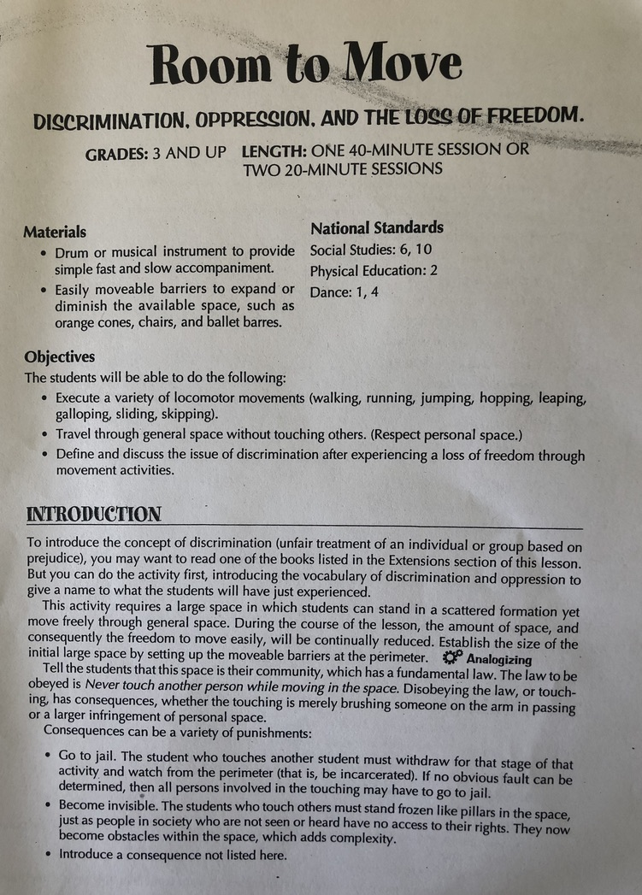
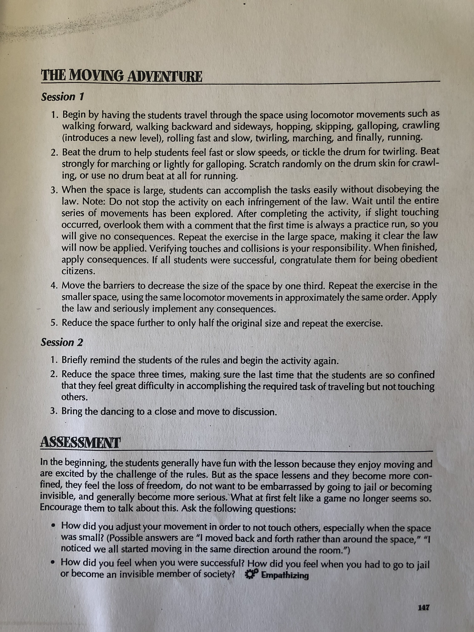

Slide 26
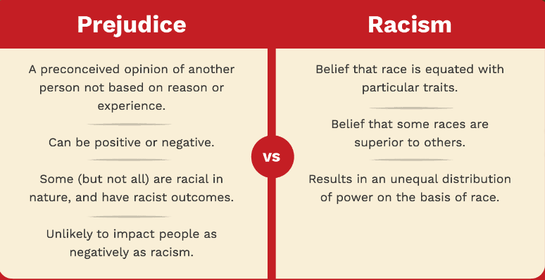
FACES of PREJUDICE & RACISM
What is Prejudice?
What is Racism?
Why are people Prejudiced? Racist?
How do we recognize Prejudice?
Racism?
Harvard Business Review:
How Hardwired Is Human Behaviour
https://hbr.org/1998/07/how-hardwired-is-human-behavior
HOW DO PEOPLE”S PREJUDICES DEVELOP
https://www.verywellmind.com/what-is-prejudice-2795476
BBC: Why overcoming racism is essential for humanity’s survival
https://www.bbc.com/future/article/20200403-how-to-overcome-racism-and-tribalism
Additional Descriptions
(members can add)

Slide 27
Thank you all for participating this evening. Please visit our facebook page and come back for the next two Thursdays to learn more about this important topic. Stay tuned for the exciting adjudicated performance opportunity we will make available for the students in October which will be virtual solo adjudicated performances based on one of our webinars.
https://www.facebook.com/Delaware-Dance-Education-Organization-537426460080876/
Sincerely, The DDEO Board
Dr. Lynnette Overby Teresa Emmons
Dr. Jane Bonbright. Tara Madsen
A.T. Moffett Erika Brown
Kimberly Schroeder Ken Richards
Marion Hamermesh Joan Warburton-Phibbs

