Slide 1
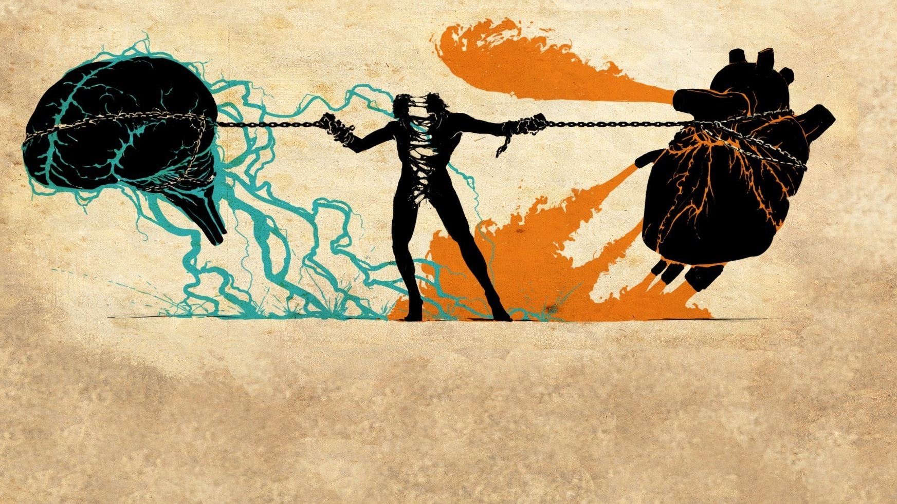
Repairing the tears in society
Equity in education- connecting and embracing our existence
Readerscafeafrica.com

Slide 2
Today’s Objectives
Explore how various “isms” including racism, sexism, ageism, and ableism contribute to the question “what constitutes an equitable environment?
Explore artistic ways to SHARE our stories and to bring a more complete and empathic understanding to the plight of others.
Explore how to connect with other artists who have shared their stories and used art to inform.
Participants will have ideas for performance opportunities with their students and access to our solos@home projects - www.ddeo.org

Slide 3
Essential Questions
What does equity mean to you?
In what ways can equity be taught, encouraged, and practiced in an educational setting at different age levels?
In what ways can art build bridges to a more complete understanding of one’s ethnicity, culture, beliefs?
How can art inform?
Notes:
We will go to break out rooms for 6 minutes to discuss these 4 questions. Whole group share out for 4 minutes

Slide 4
Our Goal Connect Create and synthesize Artistic Themes
Using a variety of tools, we will create a short “art” work that addresses the tears in society as each of us has experienced them.
By better understanding the the connections among the arts we become stronger in telling our stories
See, listen, react, connect, synthesize and create.
Notes:
Why we inserted art originally as opposed to just dance – public sector schools often need a Segway connecting dance with other art forms – to assist in bringing more value tp dance

Slide 5
Moving beyond music
So often our students rely on music and lyrics to inform and create dance works.
What other artistic means can motivate the creative process
Notes:
Caveat as to why we are not using music. Teresa - We are always creating and not simply repeating rather interpreting

Slide 6
National Arts Standards
1. Generate and conceptualize artistic ideas and work.
1
2. Organize and develop artistic ideas and work
2
3. Interpret intent and meaning in artistic work
3
4. Synthesize and relate knowledge and personal experiences to make art.
4

Slide 7
Enduring Understanding
Artists use a variety of sources as inspiration and transform concepts and ideas into movement for artistic expression
Many artistic elements are shared among the disciplines?
Art is interpreted by considering intent, meaning, and artistic expression.
As art is experienced, all personal experiences, knowledge, and contexts are integrated and synthesized to interpret meaning.

Slide 8
Some shared artistic elements, structures, principles
Visual Arts elements: color, form, line, shape, space, texture, and value.
Visual Art principles of design: balance, contrast, emphasis, movement, pattern, rhythm, and unity/variety.
Dance elements: Space, Shape (body), Time, Effort/Energy
Choreographic structures and principles: AB, ABA, Theme and Variation, Rondo, Canon, Call and Response, Repeat ,Collage, jigsaw
Elements of Drama/Poetry: Text, imagery, rhyme, rhythm, metaphor

Slide 9
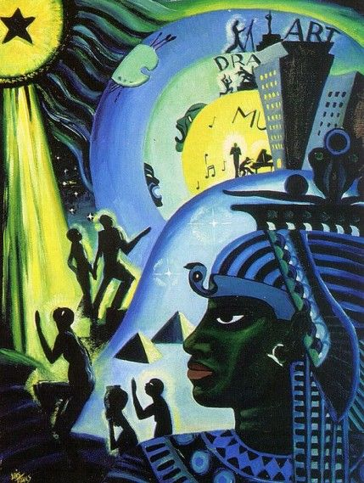
Lois Mailou Jones
Artist Intent
Line- Shape
Focal point
Positive/Negative space
Color/dynamics
Rhythm/flow
https://blog.mam.org/2020/07/13/lois-mailou-jones-and-the-ascent-of-ethiopia/
“The Ascent of Ethiopia”
Notes:
Let’s discuss how the viewers’ experience of their plight -inform write down all they see….

Slide 10
Romare Bearden Captivity and resistance https://arthistoryproject.com/artists/romare-bearden/captivity-and-resistance/
Notes:
Collage that Evokes feelings from the mutiny on the slave ship Armistad – tells a story….

Slide 11
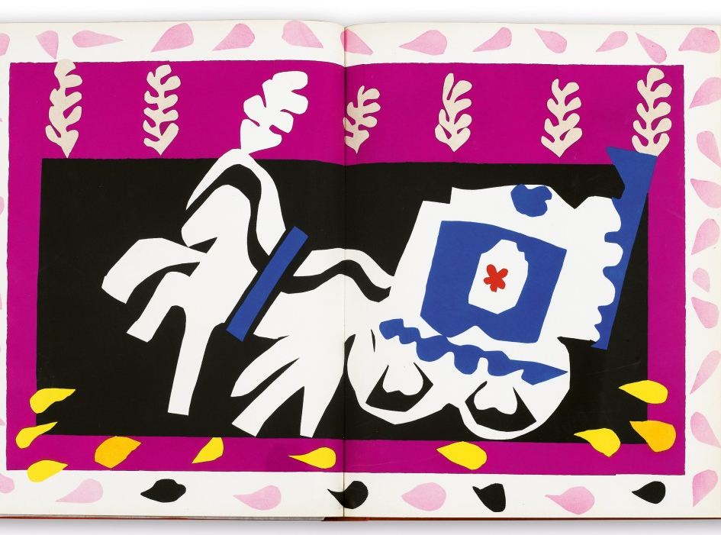
Matisse’s 'Jazz' and the Flowing Rhythms of Abstraction
Matisse was mostly influenced by Islamic and North African ar
Matisse connects expressionist art and the musical improvisation found in jazz.
https://www.metmuseum.org/art/collection/search/353770
For the full series

Slide 12
Matisse – The Dance
Notes:
1909 original and then 1910 at Hermitage,,,,caveate Add Soca….and how the past influences future for better or worse

Slide 13
Matisse’s 2 versions of the Dancer
Matisse borrowed the motif from the back of the 1905-06 painting Bonheur de Vivre
Differences in the two paintings
Notice the hands are not connected in the final version allowing the viewer in to create our own resolution?
Green blue colors are very distinctive and there is a slight shift in the green mound
Ritualistic, unbounded, and seemingly effortless nature of the dancers is evident.
Notes:
How through time our journeys are adaptable and change

Slide 14
Poetry as sources of inspiration

Slide 15
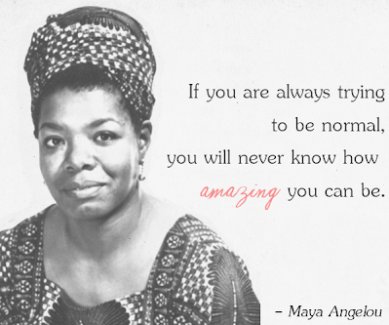
Maya Angelou – Still I Rise
Source: The Complete Collected Poems of Maya Angelou (1994)

Slide 17
Your Turn at Creating and sharing your story through art
Intentionality
Tell your story as it relates to equity and the theme “Repairing the tears in our society”.
Or in your classes you might
Start with one of the shared examples and allow the student to interpret the poem or painting from their personal perspective.
Utilize Shared elements and principles of Art from the previous slides as assists for motivation:
Collage, ABA (A motif and a B motif), Theme and variation (action/reaction)…Call and response
Space, Shape, Line, Balance, Rhythm/timing, repetition, perspective, energy, and flow
Take 15 minutes to think and create a dance.(for arts’ advocacy students might Paint, draw, write) that uses a few of these tools
We will reconvene and discuss the process and share some of the work.
Notes:
Using the prior material as inspiration –create a dance. Put Discussions afterwards to change the way of thinking and our perceptions of how we view the world. Use our somatic explorations how might we show connection

Slide 18
Excerpts from 3 students – exploring personal stories of racism
Notes:
This is the very beginning of development from speaking, writing to moving.

Slide 19
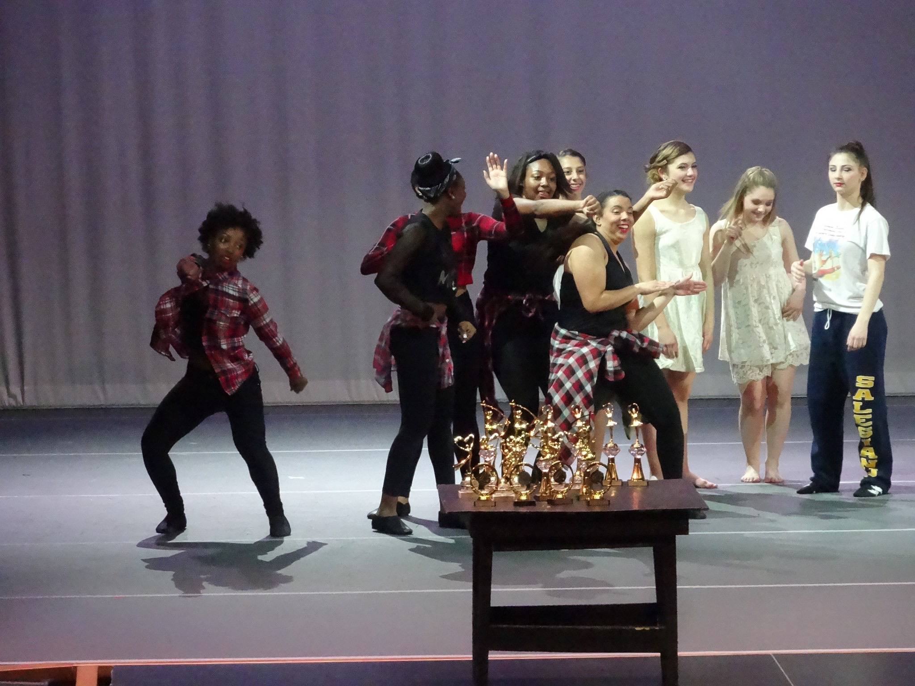
Extension opportunities for students
Visit our Webpage
www.ddeo.org and click on the resource page
Stay tuned in the next two months for an invitation to participate in choreographic workshops that will culminate in our springtime Virtual Solos@Home competition with a theme of Body Image.
Notes:
Competition with a different focus! Bringing personal expression to the table.

