Slide 1
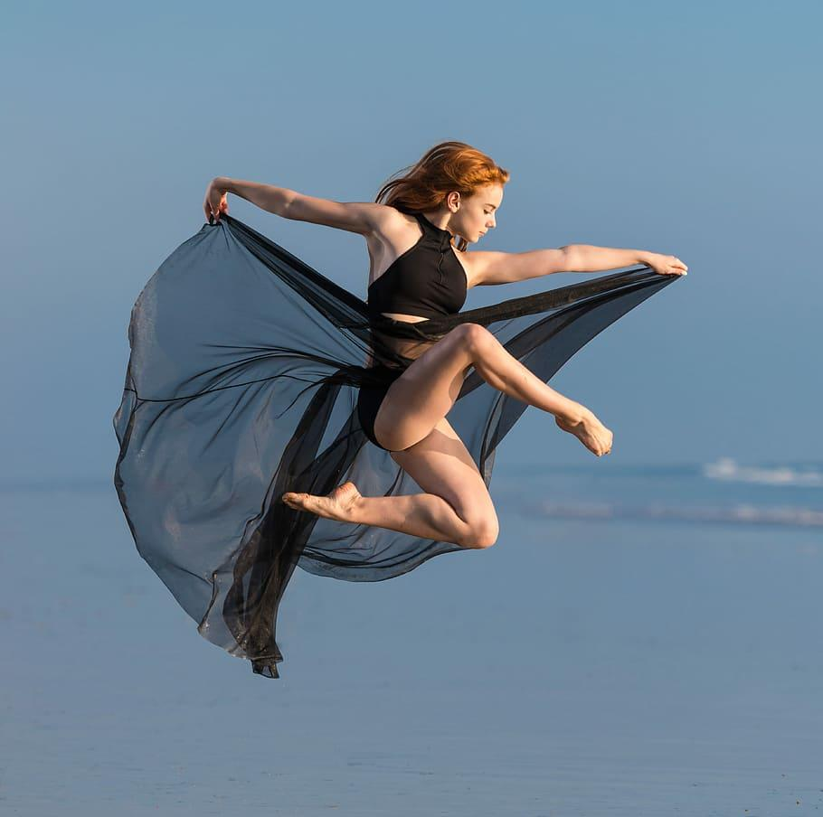
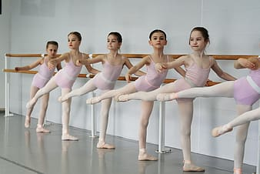
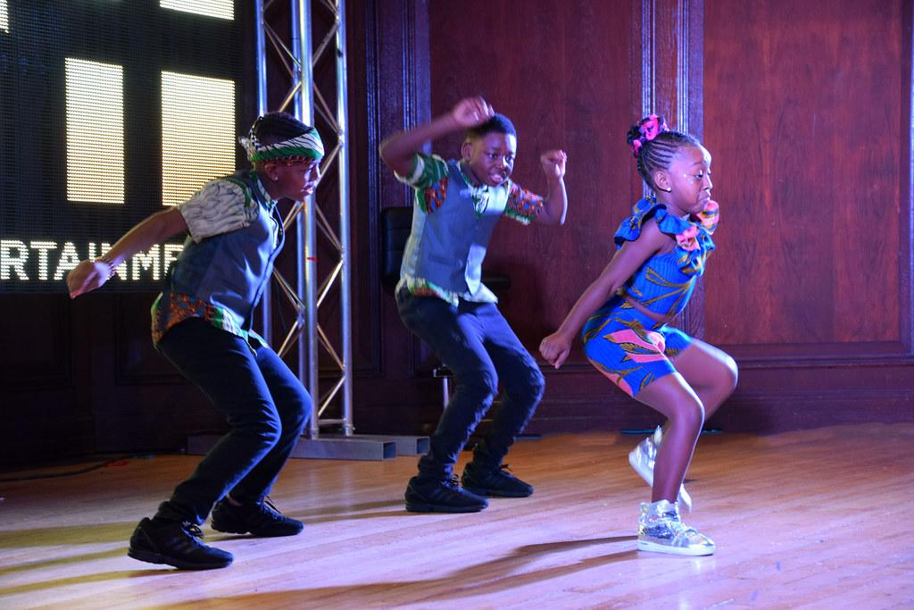
Delaware Dance Education Organization
DDEO
A State Affiliate of
Proudly Present
Notes:
Add link to ddeo and ndeo

Slide 2
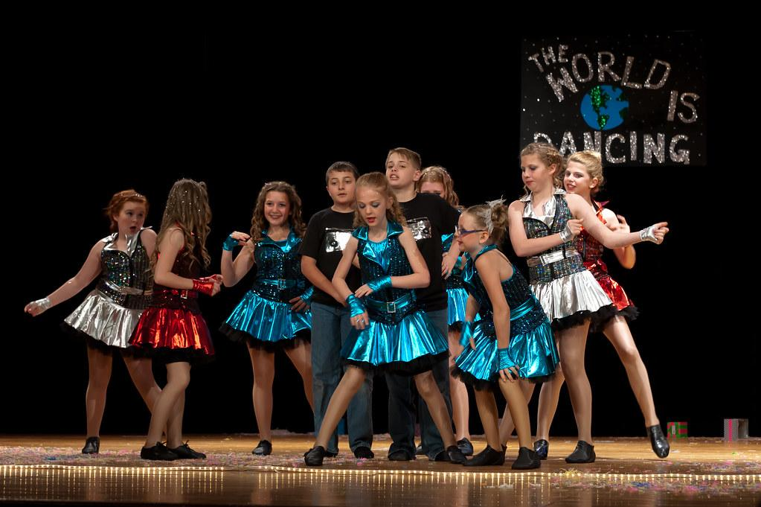
Virtual Performances
Considerations During Quarantine
Presented By: Erika Brown, Marion Hamermesh, & A.T. Moffett
May 21, 2020

Slide 3
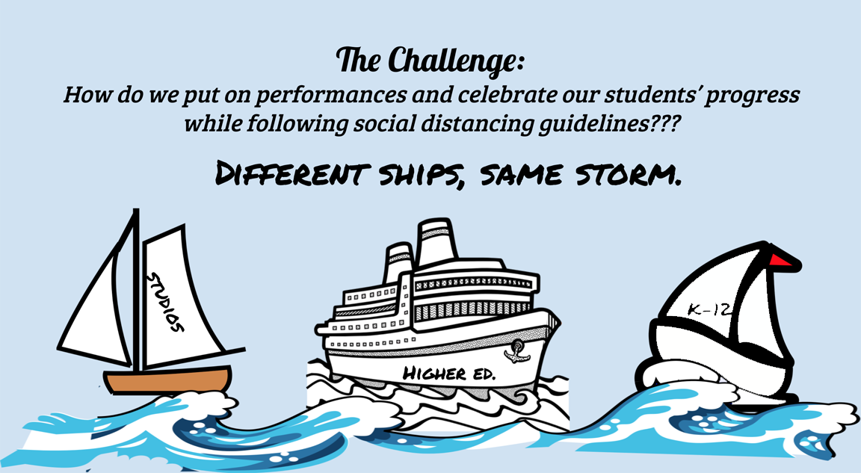
Notes:
Invitation for Dialogue 1: Get a pulse on what sectors are represented.

Slide 4
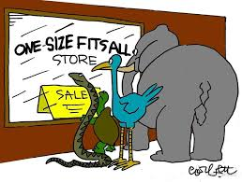
disclaimer!
Although similar in intent, we openly recognize and acknowledge that there is no “one size that will fit all.” We encourage and support creative, out of the box thinking.
Open invitation:
Use the chat for questions, suggestions or other helpful comments.
Notes:
Invitation for dialogue : Let’s invite participants to offer 1 or 2 concerns.

Slide 5
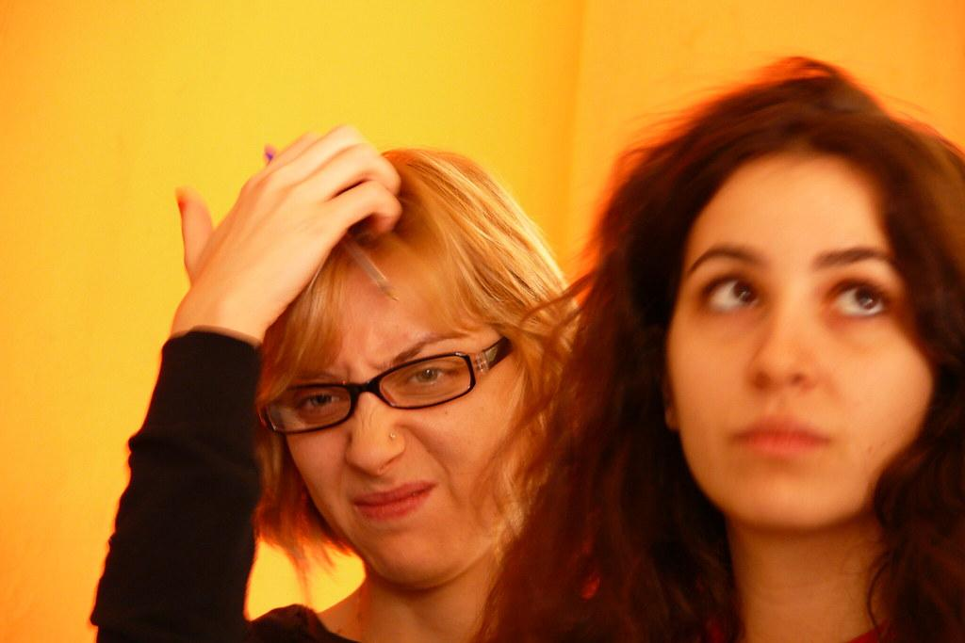
Excellent examples for the tech savvy to the newbie...
Dance Films/Video Dances
Asynchronous viewing
Virtual performances page on website
Vimeo/YouTube channel
Orange Grove Dance - Orange Grove Dance National Water Dance 2020
Artistic Directors: Collette Krogol & Matt Reeves
Notes:
Dance Film example 1
Start video at 14:20- 16:20
Orance Grove Dance: Artistic Directors Colette Krogol and Matt Reeves/ 2020 National Water Dance
Dance Film created on Zoom.
Live Zoom performance: Sell tickets on Event brite or Brown Paper Tickets and audience receives link.

Slide 6
Tech & Video Production Considerations for Virtual Performances
...that’s impressive. But, where can I?
Editing Software
IMovie! (Mac & PC)
Final Cut Pro (Mac)
DaVinci resolve 16 (Mac, PC & Linux)
DaVinci Resolve 16
www.shopifly.com
Media Platforms for Streaming
YouTube
Facebook Live
Vimeo
Instagram Live
LinkedIn Live
https://livestream.com/blog/livestreaming-platform-comparison-pricing

Slide 7
Audio Considerations for Virtual Performances
...that’s impressive. But, how do I?
Music Source
Levels
Lag time
Microphone: unobstructed & finding a quiet place to record
Editing Software: Garage Band, Audacity, & Quick Time
Music Rights: free music or public domain
Notes:
Audio: Music Source, lag time, Rights, editing
Music Rights: You Tube, Instagram, Facebook (more strict)

Slide 8
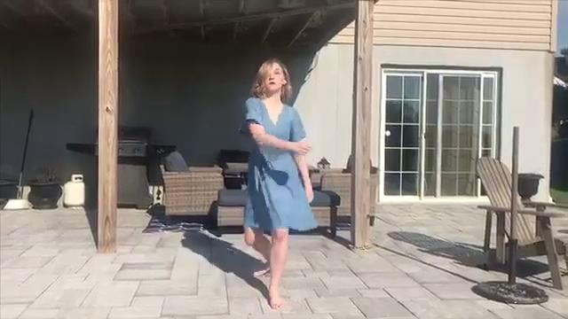
Excellent examples for the tech savvy to the newbie...
Emily Krieder ‘20 Dance Composition Washington College
Notes:
Dance Film Example 2: shot on IPhone.
Video, Audio, text editing

Slide 9
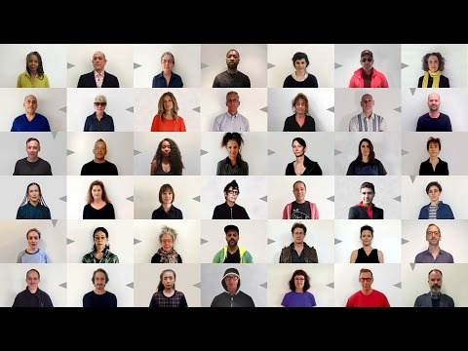
Video Reel: edited montage of single shot solos
Forward thinkers help guide our way via YouTube
Exquisite Corpse is a professionally done video that was made 3 years ago before we had ANY idea of what was coming down the pike.
Notes:
Dance Film Solo Montage: Show 30 seconds

Slide 10
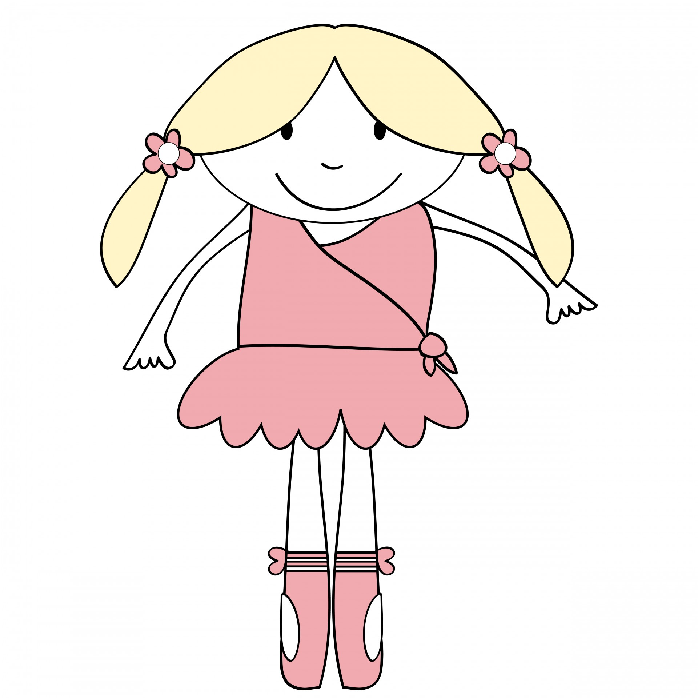
Visual Considerations for Virtual Performances
...that’s impressive. But, how can I?
Attire/Costumes
Background/Selecting a dance space
Camera placement (angle, proximity, direction)
Consistency in Camera Orientation
Lighting
Staff/Creative Team
Credits
Notes:
Watch the videos with these lists in mind.
For lighting just try to be sure there is a light source in front of you that highlights your face. Also make sure there isn’t a bright light behind you or it will make your face very dark.

Slide 11
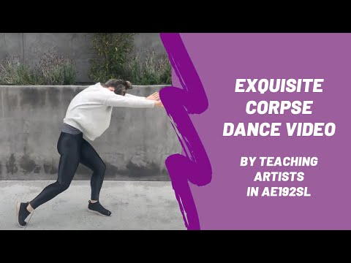
Excellent examples...
Creative student minds from UCLA offer this via YouTube
Notes:
Show one minute- let’s all look at it and think about whether or not to show the full video.

Slide 12
Excellent examples...
We know the power of art. One idea becomes an impactful dance piece. From across the globe, dancers unite “in isolation.”
https://www.youtube.com/watch?v=KP8WxCw5VEY
Quarantine Music Video - “Dance Song (for the End of the World)” - Lizzy & the Triggermen
Notes:
Question: can remove “in isolation?”

Slide 13
Excellent examples for a semi-interactive experience
Hybrid: Pre-recorded videos with interactive introduction and/or Q & A
New Curatorial Practices: Online Dance Performances /Jill Randall
Thursday May 28 7:30
markmorrisdancegroup.org/event/05-28-2020-dance-on-online-event/
Notes:
Article: Jill Randall, Life of a Modern Dancer Blog & Artistic Director of Shawl-Anderson Dance Center, Berkley
I can also share from Dance Comp performances.
See an example Thurs 5/28 7:30: Mark Morris Dance Company from tonight.
Reminder to have someone let people into zoom and man the chat feature.
Quick pause: Does anyone have a question or comment?
Mark Morris Dance On! Description: An Evening with the Mark Morris Dance Group, a free online event premiering four short videodances by Mark Morris, choreographed and rehearsed for the first time entirely via Zoom videoconference, followed by a Q&A with Mark Morris and MMDG Music Director Colin Fowler.

Slide 14
Quick Pause and Check In
What might work for you?
BENEFITS: Accessibility, showcase dancers work in new ways, develop new
skills, improve web presence, free tutorials
CHALLENGES: Variations in video/audio quality, connectivity, storage,
tech expertise, time
Ideas?
Notes:
Start video at 14:03
Orance Grove Dance: Artistic Directors Colette Krogol and Matt Reeves/ 2020 National Water Dance
Dance Film created on Zoom.
Live Zoom performance: Sell tickets on Event brite or Brown Paper Tickets and audience receives link.

Slide 15
Recital Ideas for Studio Owners & Teachers
Outdoor venue for safer social distancing
Senior showcase: special recognition for the graduating seniors
Simultaneous Zoom performances in costume, option to record
Awards
Single class performances in auditorium/solos in studio
Audience Options: Invite 1 adult for live viewing; live stream, or both
Can then compile videos and present a hybrid performance event
Considerations: Additional staff, volunteers, & training for social distancing measures.
Notes:
Studio solos: rig up a backdrop (curtain & PVC pipe) or green screen. All students perform solos individually. Cost effective but time intensive.
Single class performances: one class at a time, one invited adult
Outdoor venue: parks, amphitheaters, one class at a time, acoustic challenges.
Senior showcases: o

Slide 16
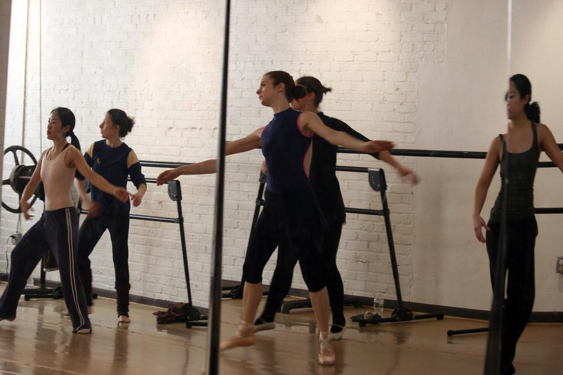
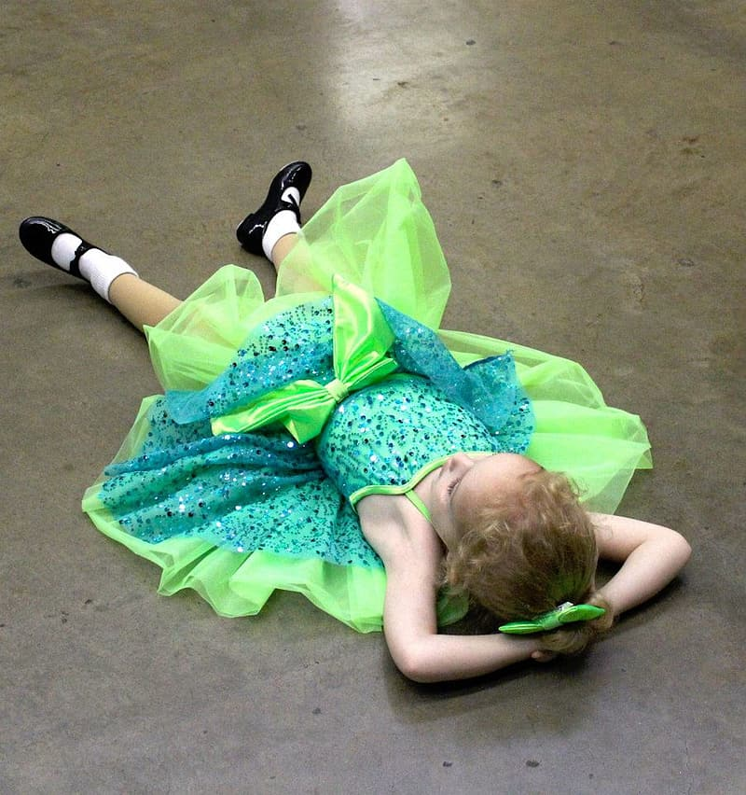
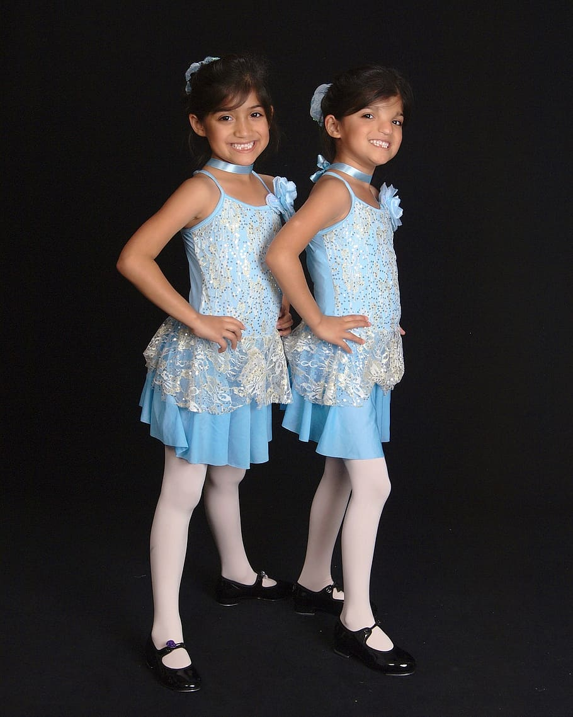
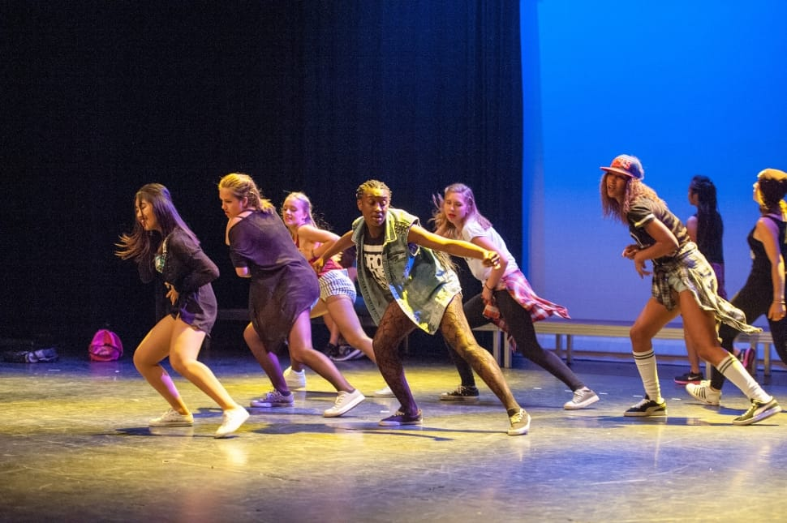
Preparing for Recitals:
Pre-record choreography.
Enlist an older youth to “aide” for the class and learn it. Provides a model other than you
Screen share pre-recorded video and offer feedback during Zoom classes
Drive through costume pick up for quick, personal check in
Virtual costume parade
Rehearsal in costume for special moments
Notes:
CUT IT?? Studio solos: rig up a backdrop (curtain & PVC pipe) or green screen. All students perform solos individually. Cost effective but time intensive.
Single class performances: one class at a time, one invited adult
Outdoor venue: parks, amphitheaters, one class at a time, acoustic challenges.
Senior showcases: o

Slide 17
Practical Matters...
Where’s the

Slide 18
Tiered Ticket Prices: Watch Live, Limited Access, & Unlimited Access
EventBrite - www.eventbrite.com
Sell tickets in the app
Log in on your device.
Choose your event (on the "Select Event" screen).
Tap "Sell".
Add tickets and select a payment method.
Check in attendees or process a new sale.
Brown Paper Tickets
https://www.brownpapertickets.com/services.html

Slide 19
Ticket Sales: Continued
Ticket leap -https://www.ticketleap.com/info/sell-tickets-online?rc=ORG-google-/info/sell-tickets-online
Click the Get Started button above to create your free Ticketleap account.
Customize our event page template with your images, words, and, of course, tickets.
Start sales and share your event page link wherever your buyers are.
Yapsody
https://www.yapsody.com/ticketing/how-to-sell-tickets-online/

Slide 20
Soliciting Donations
ONLINE PAYMENT OPTIONS
Venmol https://help.venmo.com/hc/en-us/articles/210413477-Sending-Requesting-Money
Paypal https://www.paypal.com/us/home
Zelle https://www.zellepay.com/how-it-works
Givelify https://www.givelify.com/
Cashapp https://cash.app/
Notes:
Discuss examples of how this might be lucrative: people can offer donations above and beyond the ticket price.
How this works: put the information in the Chat.

Slide 21
Increasing Revenue
Request rehearsal rate for venue rental (less tech, less wear & tear on facilities)
Program sponsorships to be listed in credits.
Recruit volunteers to help promote the performance (sign up genius)
Summer 2020, offer dance workshops for new audiences not yet represented in your studio or program.
Notes:
Maybe leave out of discussion but include in PP
Studio solos: rig up a backdrop (curtain & PVC pipe) or green screen. All students perform solos individually. Cost effective but time intensive.
Single class performances: one class at a time, one invited adult
Outdoor venue: parks, amphitheaters, one class at a time, acoustic challenges.
Senior showcases: o

Slide 22
Considerations for Nurturing Community
...that’s impressive. But, how do I nurture my community?
Awards & Recognitions
Audience “adjudicators” - spectators given criteria before the performance to vote on areas like: most innovative use of tech, most creative, I love to Dance award, best use of a small space, best musical interpretation, you make me smile award….etc etc…
Studios could come with their own awards and their own criteria
Recognition of any and all volunteers.
Solos, Special Dedications
Seniors solos, Graduate dance
Essential employees/families affected by coronavirus
Memorials
Scholarships
Online workshops/classes
Notes:
Here let’s invite Joan to talk about how she did this at Cab?

Slide 23
Let’s Get Creative!
What are the opportunities here?
Invite students to refine their video editing skills (resume, portfolio, relationships)
Site specific Dance: see familiar spaces in new ways
Tik Tok
Drive-in movie style dance performance
Seattle Drive In Dance Performance
Notes:
I had an alumni call me yesterday with an idea. While they were walking through the woods of Alapocas, they thought that it would be cool if students danced in a clearing in the woods while the audience socially distanced around in a theater in the round style. This time is definitely inspiring out of the box thinking.

Slide 24
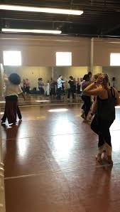
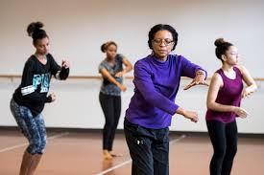
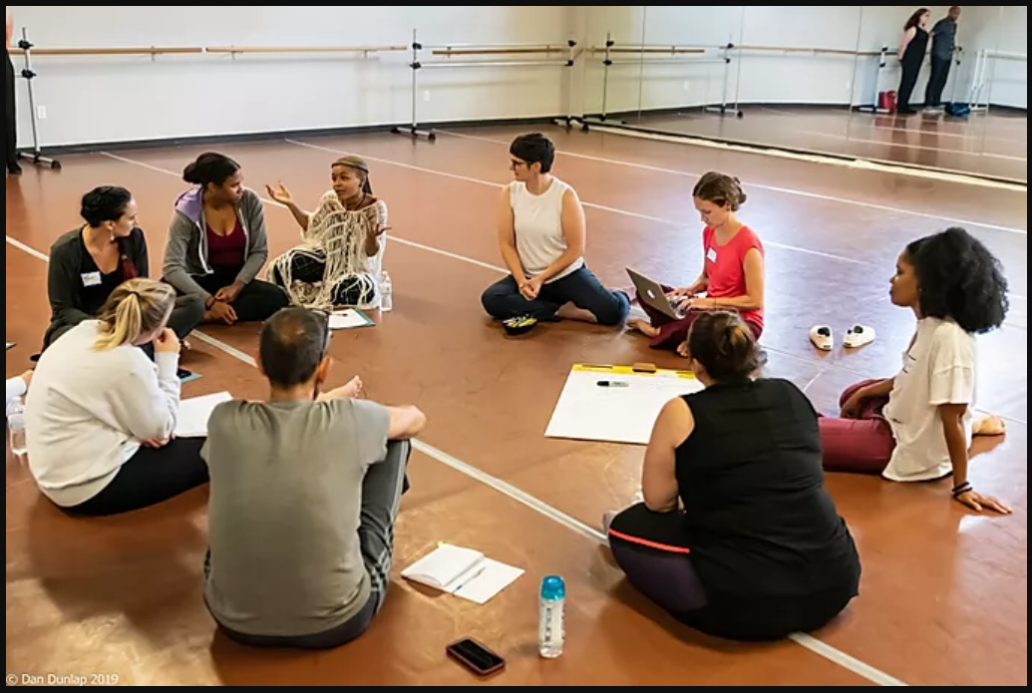
Join DDEO Today!
Be A Part of Our Team of Dance Educators Working for Delaware’s Children.
By joining DDEO, you have a dual membership with our DDEO and NDEO. Membership benefits allow you access to many different opportunities, including the following:
​
Professional Development
Opportunities for Leadership
Research and Publications
Awards and Scholarships
Standards for practicing Dance Education
National Honor Society and Recognitions
A Network of Leads and Peers
A National Voice to advocate for Dance Education
Individual Memberships
Professional Member: $115/year
Ph.D./Ed.D. Candidate member: $115/year
Young Professional: $85/year
Retiree Member: $60/year
​
Student Memberships
Graduate Student: $75/year
Undergraduate Student: $50/year
​
Institutional Memberships
Dance Studio: $185/year
K-12 Schools: $185/year
Performing Arts Organization: $185/year
Higher Education Institution: $250/year
https://www.ddeo.org/join
Notes:
I had an alumni call me yesterday with an idea. While they were walking through the woods of Alapocas, they thought that it would be cool if students danced in a clearing in the woods while the audience socially distanced around in a theater in the round style. This time is definitely inspiring out of the box thinking.

