Slide 1
Groundswell: Dance as a force for social change
Taking it to the Next Level: Jazz Dance for the Curious Dance Teacher
Presenters: Erika Brown, Kimberly Schroeder, & A.T. Moffett
Notes:
Introduction by Lynnette
Erika - Highlight that this style came from African roots and we are going to share ways to implement that idea into our studio teaching; to bring acknowledgment into our studio teaching
Kim - short movement - Call & Response

Slide 2
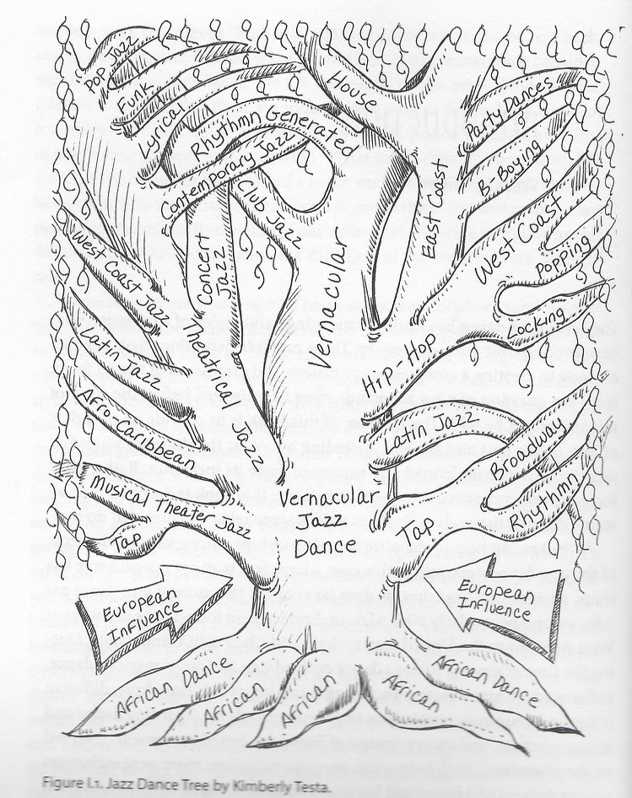
In this webinar we will examine the depth and breadth of styles within the genre of American jazz dance, the historical foundations of jazz, and the avenues of deepening our pedagogical practices for the benefit of ourselves and our students. We will offer studios exercises, ideas for assignments, projects and student friendly articles.
Image: Jazz Dance Tree by Kimberly Testa
Jazz Dance: A History of the Roots and Branches (2014)
Notes:
We are the arborist of this particular tree!

Slide 3
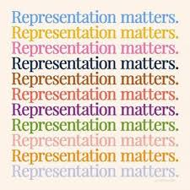
Terms:
Inclusion: Authentically bringing traditionally excluded individuals or groups into processes, activities, and decision making in a way that shares power.
Critical Dance Pedagogy: Thinking about who/what is supported
in our classes? And who/what is not?
Culturally Relevant Teaching: Teaching that affirms and
celebrates the identities and cultures of the students in
the room.
Next Level Jazz: An evolving approach to teaching jazz dance that centers and celebrates the African roots of the style even if it is outside of one’s training and experience. It is a commitment to deepen one’s understanding and embodiment of the social and kinetic elements through personal study, trial and error, and practice over time.
Sources: Dance Pedagogy for a Diverse World by Nyama McCarthy-Brown (2017)
UW School of Public Health
https://epi.washington.edu/sites/default/files/website_documents/DEI%20Glossary_Formatted_20190711.pdf
Notes:
Erika: share story about attending Lindsay Guarino’s NDEO workshop with your home experience - clear example of culturally relevant teaching; reflective loop of being a teacher who has a student related experience and can cycle that back into your teaching

Slide 4
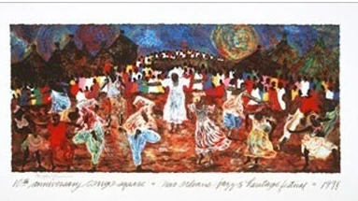
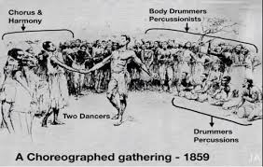
West African Roots of Jazz Dance
Transatlantic slave trade/Diaspora
Mixing of African peoples
Music & Dance as a means to preserve culture
Restrictions imposed on singing and dancing
Exchange between African and European dancers in America
Top Image: Aziz Diagne
Bottom Image: https://face2faceafrica.com/article/congo-square-the-spot-in-new-orleans-where-enslaved-africans-created-jazz-music
Notes:
A.T.: When we think about jazz - both as presentational form but also a social form - that sensibility informs how we are instructed to perform competition jazz/musical theatre; keeping performance fresh every time; also a ritual form

Slide 5
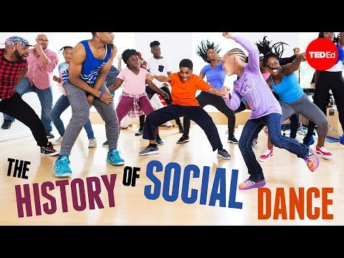
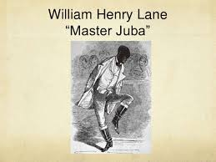
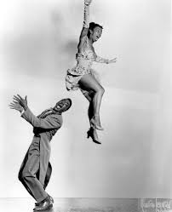
Jazz’s Evolution within the US
Minstrelsy & black face begins around 1830s
Civil War: 1861-1865
Jim Crow era: Post civil war - 1968
Vaudeville 1880s-1920s
1920: The Roaring Twenties/ Jazz Age/Harlem Renaissance/Prohibition/Women’s Suffrage
Lindy Hop
Charleston
Jitterbug
30s: Big Band era/Swing era
Savoy Ballroom
Cotton Club
Top Image: google images
Side Image: NY Times Norma Miller and Billy Ricker, of Norma Miller’s Dancers, in a publicity photo taken in about 1940.Credit: Michael Ochs Archives/Getty Images
Notes:
A.T.: These factors lead to the development of jazz dance. We see jazz dance as a social formand vernacular dance. We have The Jazz Age in the 1920s & 1930s, the HArlem Renaissance, an out pouring of artistic activity,,,
Add to this slide: Years of Civil War and period of Jim Crow - backlash against choice to do away with slavery
Vaudeville: variety show format that included jazz dance and tap dance acts
Is this too much info? If so, feel free to edit.

Slide 6
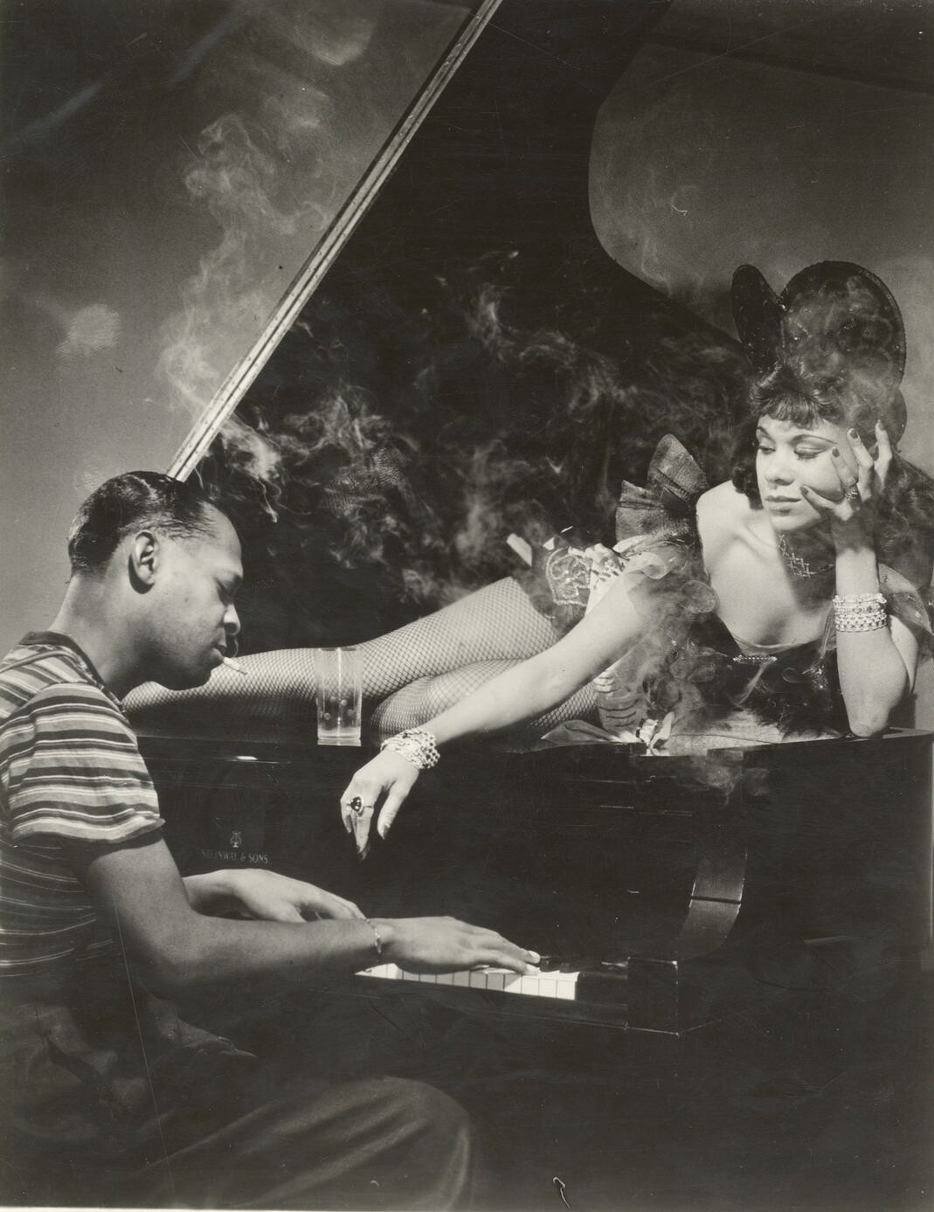
Jazz’s Evolution Continued
WWII: 1939-1945
Bebop new wave/swing the voice of America
Disruption of the music & dance connection
Jazz in feature films, staged productions, and musical theatre 1930s-today
Style starts to become codified
Precision over individuality
Style merges with ballet and modern dance
MTV Music Videos: 1980s
2000s: SYTYCD and widespread dissemination of jazz and dance through television & popular media
Image: Library of Congress/Katherine Dunham in Le Hot Jazz
Notes:
A.T.: These factors lead to the development of jazz dance. We see jazz dance as a social formand vernacular dance. We have The Jazz Age in the 1920s & 1930s, the HArlem Renaissance, an out pouring of artistic activity,,,
Add to this slide: Years of Civil War and period of Jim Crow - backlash against choice to do away with slavery
Vaudeville: variety show format that included jazz dance and tap dance acts
Is this too much info? If so, feel free to edit.

Slide 7
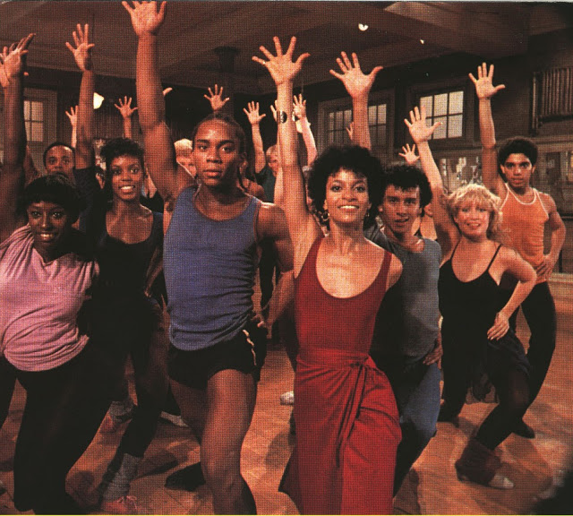
Impact of Racial Issues on Jazz Dance
Segregation
Black Face
Discrepancy in available opportunities for
Black & White performers
Accomplishments not recognized
Image: Debbie Allen Fame TV series

Slide 8
Social Elements
Community- the circle
Indiv. creativity within the group
Vocal encouragement
Lack of separation between performer & spectator
Friendly challenges among dancers
Confrontational attitude “in your face”
Joyousness
Call-and-response
Interaction between musicians & dancers
West African/African American/Authentic Jazz
Kinetic Elements
Use of flat foot
Bent knee, hip, & ankle joints
Articulated, inclined torso
Body part isolations
Groundedness (earthiness)
Improvisation
Embellishment & elaboration
Polyrhythms & syncopation
Polycentrism
Angularity & asymmetry
Personal expression & creativity
Source: “Jazz Dance as a Continuum” Pat Cohen in Jazz Dance: A History of the Roots and Branches (2014)
Notes:
When we think about jazz - both as presentational form but also a social form - that sensibility informs how we are instructed to perform competition jazz/musical theatre; keeping performance fresh every time; also a ritual form
Kim - leads experiential #2 - guided improvisation (walk away from camera/turn and come to camera/see someone in the zoom room and strike your “attitude”) - joyousness, confrontational attitude; friendly challenge; indiv. Creativity with in the group; groundedness; personal expression; improvisation

Slide 9
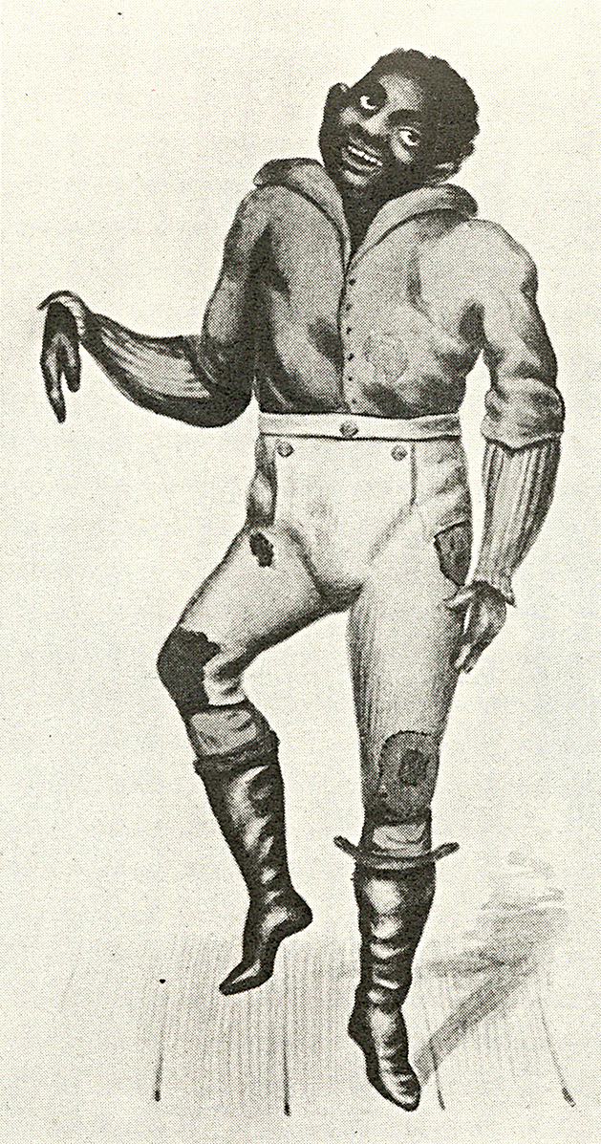
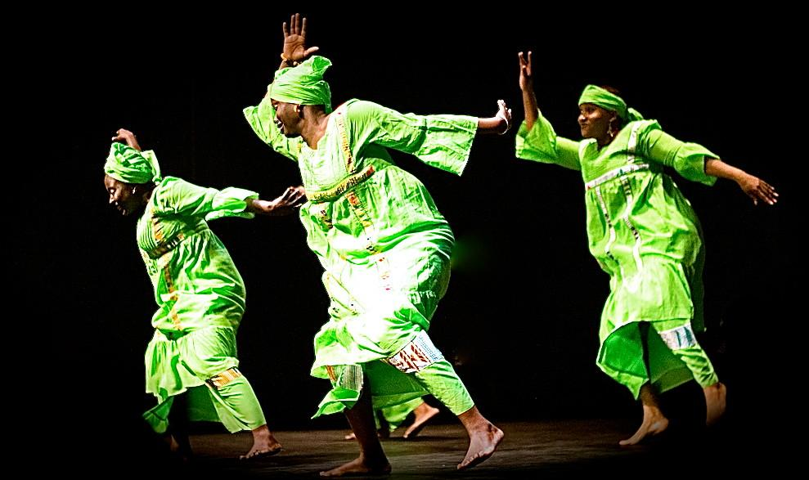
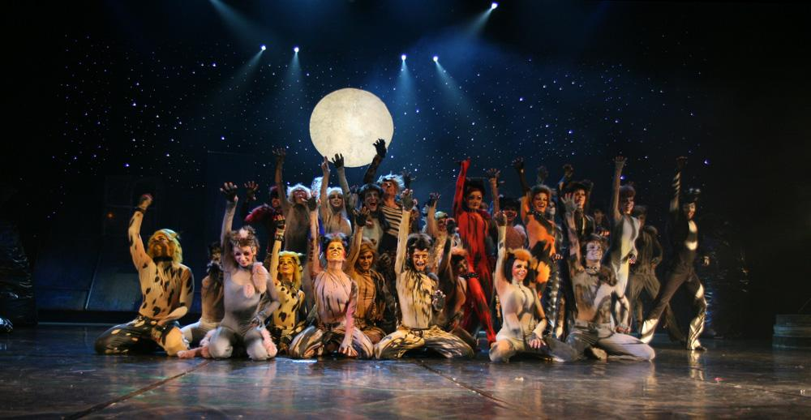
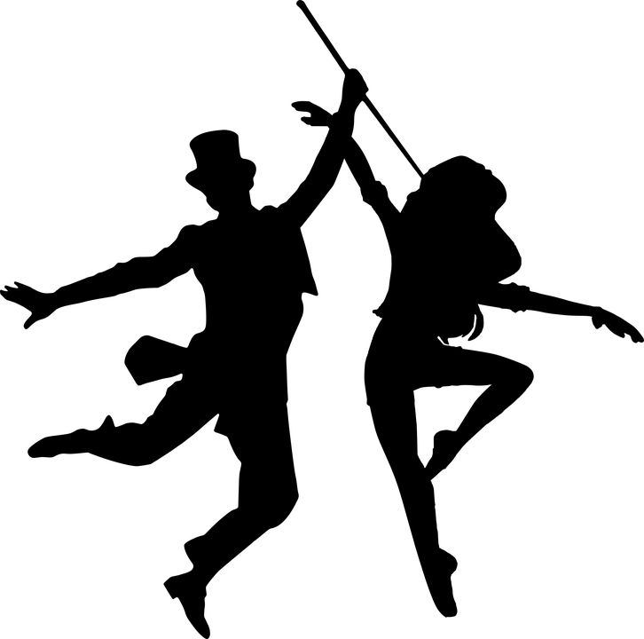
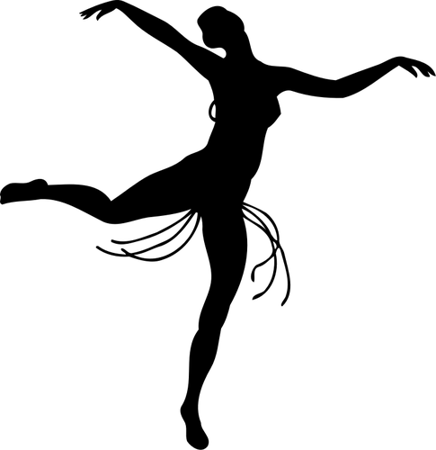
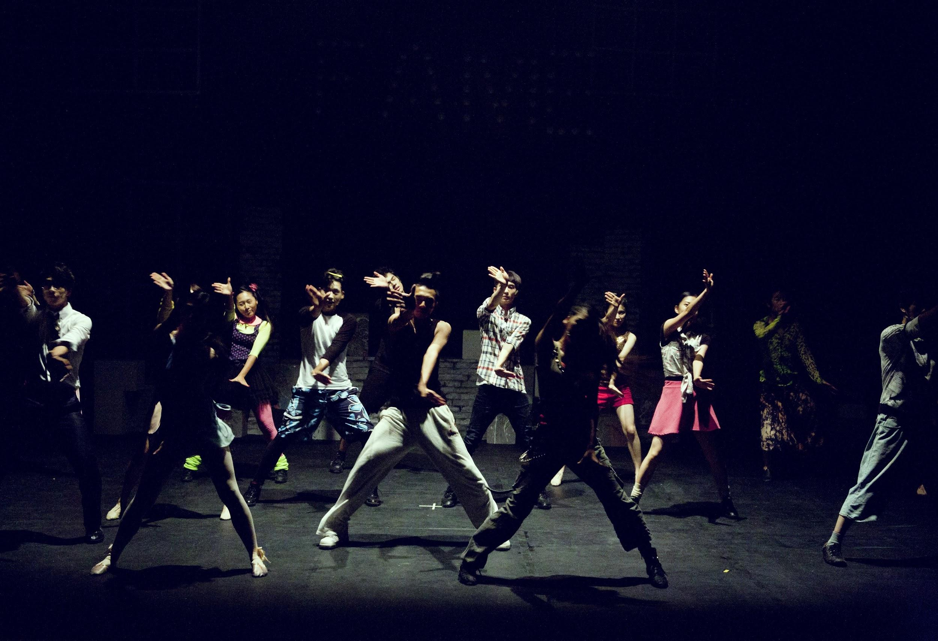
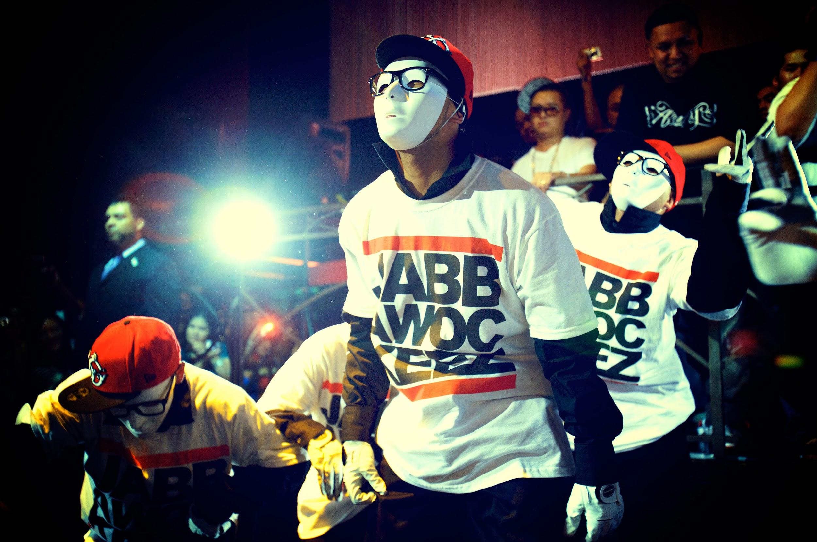
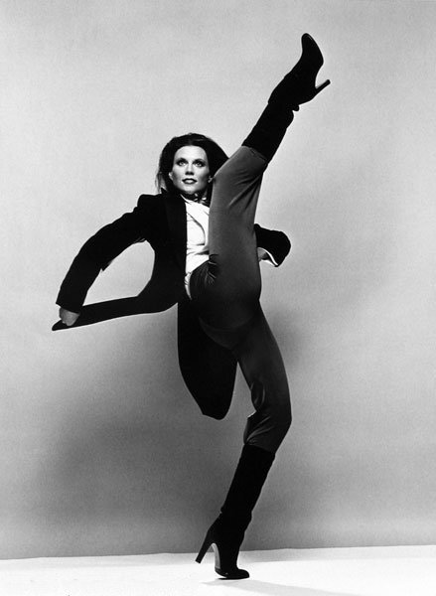
Jazz Dance Styles
Where do you live in the tree?
Notes:
Erika covers -as educators and practitioners, we encourage active reflection on where you stand in your placement in the tree (roots, trunk and branches). And just as ballet styles are credited (classical, russian, french, vaganova method, cecchetti …) we encourage a possible “reframing” of course titles and content as you move forward in awareness….
Video examples: African Dance - show this at the beginning of presentation; Swing/Lindy; Musical Theatre; Include a video of what the average person thinks is jazz and hip hop
A.T. - add musical theatre link; Kim - Lindy video

Slide 10
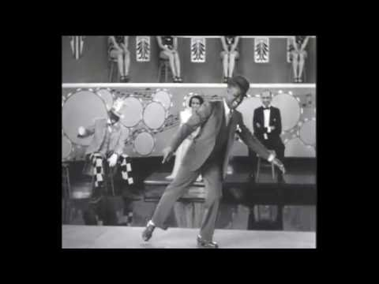
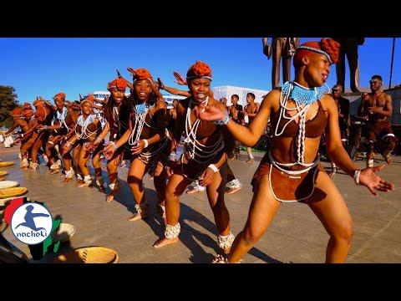
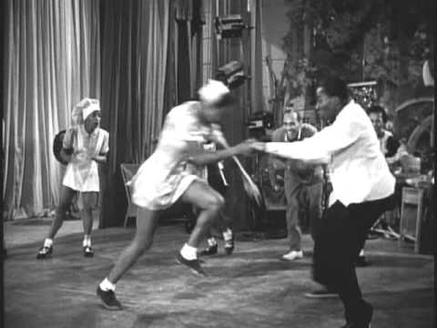
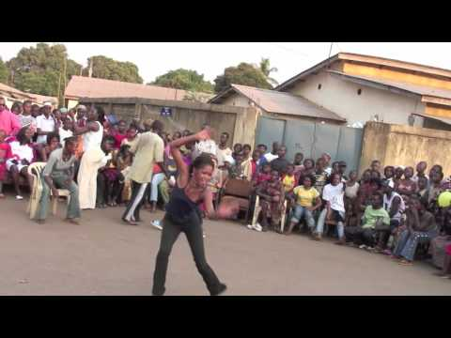
Jazz Dance Roots and Branches Visual Aides
1934 Tap Dance (Bill Robinson)
Whtey’s Lindy Hoppers - Hellzapoppin (1941)
Five Traditional African Dances You Have to Watch
:
Dundunba #4 Community African Drum and Dance party in Guinea, West Africa 3:05
Notes:
Elements to note:
Video 1: West African - community/social, grounded, flat foot. Articulating torso
Video 2: West African - community, improvisation, friendly challenge
Video 3: Bill Robinson - 1 minute virtuoso, timing, musicality, easy grounded posture
Video 4: Hellzapoppin - Lindy hop - simply amazing, athleticism (great depression)

Slide 11
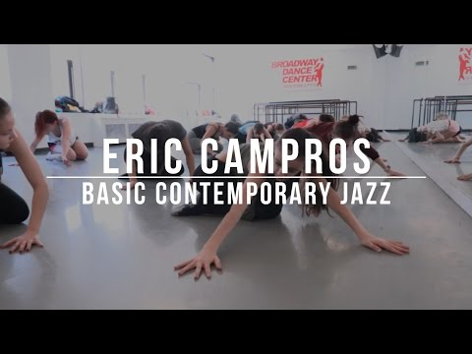
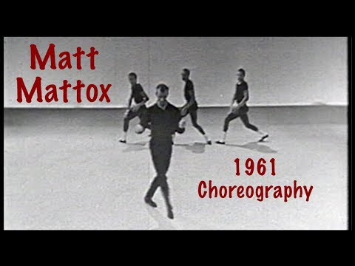
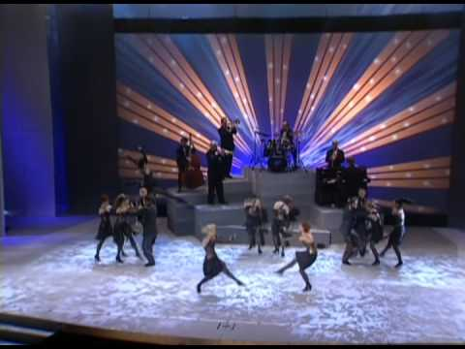
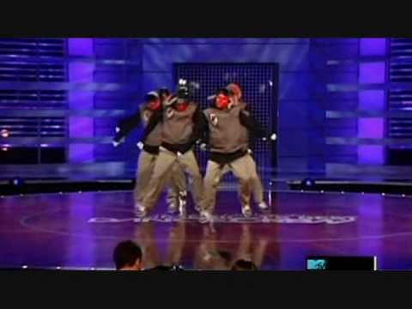
Jazz Dance Roots and Branches Visual Aides
Commercial for Contemporary Jazz Class - Broadway Dance Center: Eric Campros
Jabbawockeez - ABDC Week 7
Matt Mattox 1961- Jazz dance Choreography - Introduction
Sing, Sing, Sing - Fosse (Original Broadway Production 1998)
Notes:
Moving forward in time:
Video 1: Fosse’, broadway jazz 1998
Video 2: 1961 Jazz - Matt mattox Jazz choreography
Video 3: Contemporary jazz (today) , although far removed from the west african roots, still retain the groundedness, articulation in the torso and isolation work. It is indeed still infused with elements of its heritage
Video 4: Hip Hop - dance compilation, high energy, in your face, polycentric movement
https://www.youtube.com/watch?v=K6u-cu5WerM
Top 10 Viral African Dance Styles that Hit Internationally
https://www.youtube.com/watch?v=dHVNiSodDB
West African Dance Company | Afriky Lolo | TEDxGatewayArch
(watered down???)

Slide 12
Tips & Techniques
01
Taking jazz to the NEXT LEVEL!
Vestibulum nec congue tempus
Vestibulum nec congue tempus
Next Leve Jazz Dance Pedagogy
Exercises
IDEAS
03
02
Vestibulum nec congue tempus
Jazz Dance Pedagogy

Slide 13
Taking Jazz to the NEXT LEVEL!
Improvisation
01
Connect with
the eyes
Call & Response
Connect with self, music & each other
Vestibulum nec congue tempus
Next Leve Jazz Dance Pedagogy
Jive & Groove
Entrances/Exits
02
Circle
Vestibulum nec congue tempus
Jazz Dance Pedagogy

Slide 14
Exercise in Isolation & Polyrhythm by Melanie George
Notes:
I learned this exercise in a jazz dance master class with scholar, Melanie George. It’s an excellent way to incorporate polyrhythm into your jazz isolation warm up and a fun brain teaser!

Slide 15
Next Level Jazz ...
has a unique set of norms
is embedded in social styles
is the idea of being fully self expressed
feels the connection and builds community
develops the dancers’ musical ear & musicality
is always evolving, yet rooted
is exciting and more than your “typical” technique class
moves beyond what we have been taught
acknowledges our responsibility to embrace and engage our students while honoring its roots & supporting the works of great dancers, teachers and choreographers before us

Slide 16
Resources
Warm Up:
Isolations, stretching, floor work, plies, tendus
Center Technique:
Pirouettes, other tricks & stunts
Across the Floor:
Jazz walks/runs, Leaps & tricks
Center Combination:
64 counts to your favorite pop song facing the mirror
Familiar Lesson Plan

Slide 17
Resources
Pre-Warm up:
Call & Response to connect with your dance community
Warm Up:
Make it a social dance warm up to get the blood flowing; Polyrhythmic Isolations, stretching & floor work with a focus on musicality; plies & tendus with some groove and different facings
Center Technique:
Pirouettes, other tricks & stunts
Across the Floor:
Groove, Jive, be grounded, be cool and throw in a trick or two :)
Center Combination:
64 counts with a partner or changing partners, incorporate individual entrances/exits, include 4 cts of improvisation
Cool Down:
Finish class in a circle - encourage students to lead a call & response embracing their own cultural roots
Next Level Lesson Plan with ideas from African roots

Slide 18
Resources
Jazz Dance Class on Spotify
Next Level playlist

Slide 19
Resources
Jazz Dance Roots and Branches Video Resources
https://www.youtube.com/watch?v=qo6lPifGnGA&list=PLZ_DnuOnH6dcJJumUgIGK3e51GVTZ9j0Y
Broadway tap: Anything Goes performance on the 2011 Tony Awards
https://www.youtube.com/watch?v=VioVokOeCHk&list=PLZ_DnuOnH6dcJJumUgIGK3e51GVTZ9j0Y&index=2
Broadway tap example: 42nd Street
https://www.youtube.com/watch?v=1xnHJI89PcE
1934 Tap Dance (Bill Robinson)
https://www.youtube.com/watch?v=XihAOf2yCJc
Latin Jazz Dance. "In the Heights". Juanjo Hinojosa
https://www.youtube.com/watch?v=Fl0iT0v_fMs
Example of Afro Carribean Jazz: Afro Jazz with Azreale
History and Concept of Hip-Hop Dance | Documentary | Moncell Durden
https://www.youtube.com/watch?v=EAhRvgkurRM
Musical theatre tribute to Black choreographers.
https://www.youtube.com/watch?v=IvDNz6Iw3Lw
Frankie Manning Documentary: Never Stop Swinging
https://www.youtube.com/watch?v=Rp8Zc15gCCI
Plantation Dance Ring Shout
https://www.youtube.com/watch?v=NQgrIcCtys0
Chuck Davis Dancing Through West Africa
https://search.alexanderstreet.com/preview/work/bibliographic_entity%7Cvideo_work%7C1664020
Notes:
These are great. Let’s plug in throughout.
https://www.youtube.com/watch?v=qsrOdrDqqk0 Chicle chat ep 10: Lyrical, modern, contemporary, what’s the difference (funny - kid is confused...excellent example of the muddled nature surrounding jazz)

Slide 20
Resources
B. Within your chosen style, describe the aesthetic. (In other words, what is the movement like and how does it connect with the music? Where is the typically seen? Is it more social, presentational, or a combination?)
C. How does this style of jazz dance reflect popular culture and/or the historical context of the era in which it was popular?
D. Show a video of an iconic work from this jazz dance style and choose 2 of the categories to discuss.
1) The music and dance relationship
2) How the dancers relate to each other
3) Notable characteristics of the movement vocabulary. (Africanist influences? European influences?)
4) What stands out to you and how you connect with the dance?
Jazz Dance Group Presentation
for Undergraduates
Assignment Prompt:
Students will work in small groups to present a 15-minute presentation about their chosen branch of the Jazz Dance tree. (Image taken from Jazz Dance: A History of the Roots and Branches.) Presenters will discuss:
A. 2 key figures from your chosen jazz dance style. For both figures, give a description of their work & their most significant contributions to the field of jazz dance

Slide 21
Resources
Jazz Dance: A History of the Roots and Branches
Nyama McCarthy-Brown Makes a Case for Culturally Relevant Teaching
Expanding Musical Literacy
Thinking on our Feet: Improvisation for Individual & Community Expressions in the Jazz Dance Class by Erinn Leibhard
It Don't Mean A Thing If It Ain't Got Musicality by Erinn Leibhard
Readings & Articles

Slide 22
Q & A/Discussion
Notes:
Lynnette suggested: Think about one way you can take what you have learned from these workshops and how you can implement/use this material and put it in the chat
Incorporate: Either a video or a quick question to the group or even a stretch - something to help digest - Chat survey: Scale 1-10 - how aware do you think your average student is of these foundations? How are you bringing in American History and awareness into your jazz class already? Do we feel that this level of awareness is adequate? Why?
Survey the participants on what style they think they teach; or what examples they already have; connect these ideas through the earlier slides
Exercise: 1) Identify what you teach; 2) Identify what you have learned from the roots that we highlighted/presented could include to enrich your teaching; 3) Add a new idea to what you already offer (Kim’s example of Melanie George’s isolation/polyrhythm example

