Slide 1
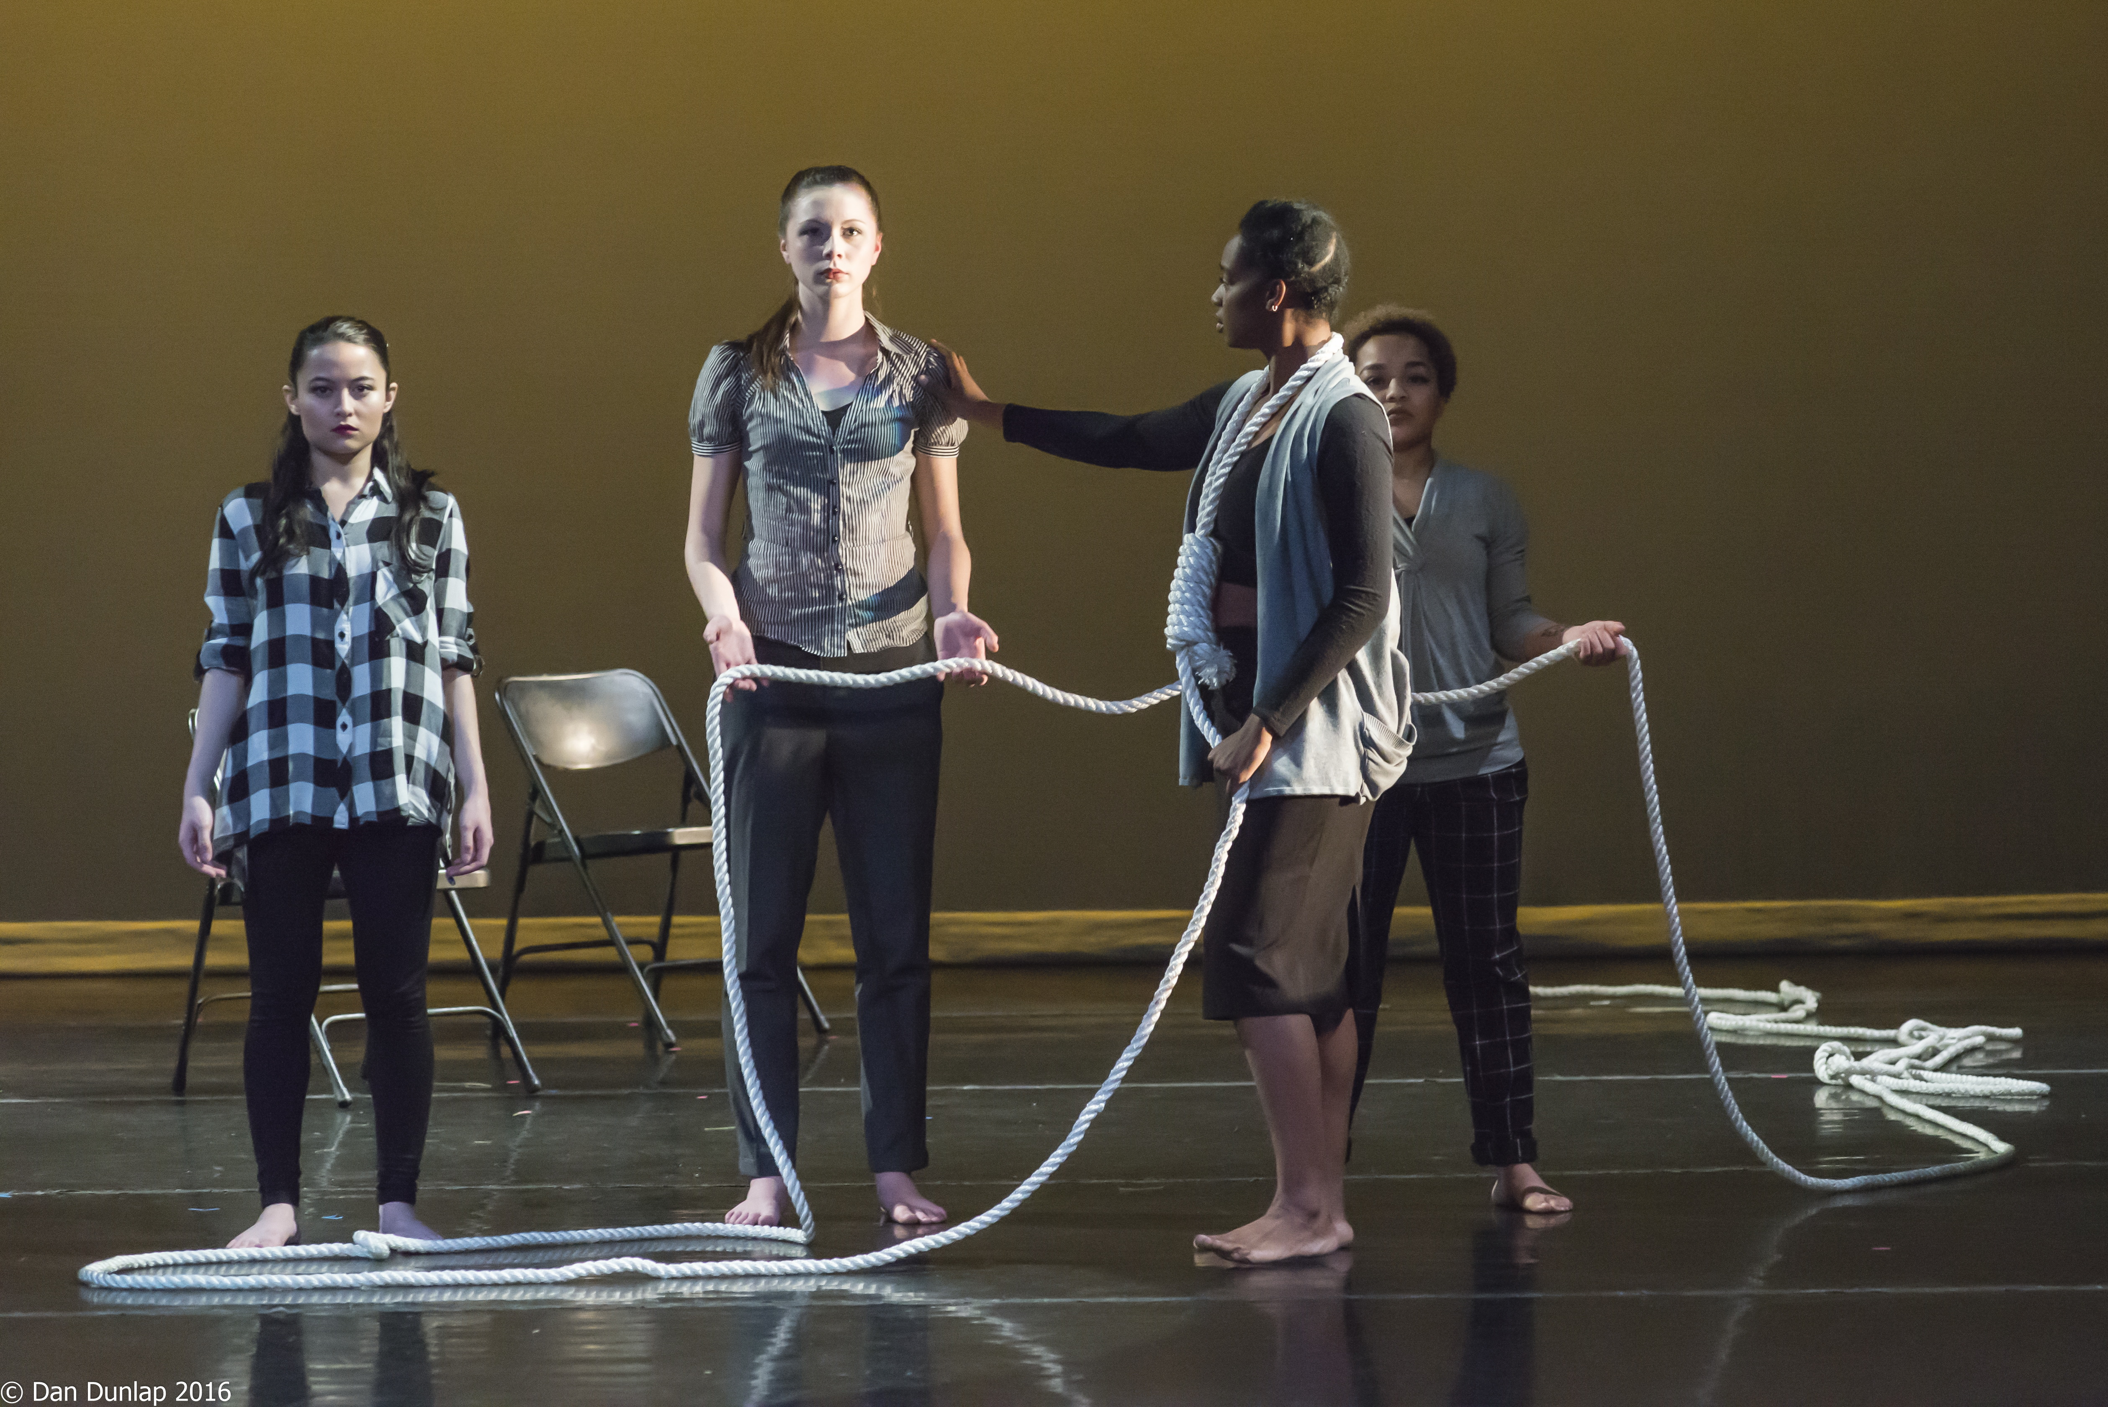
Groundswell: Dance as A Force for Social Change
Delaware Dance Education Organization in Collaboration with the Partnership for arts and Culture

Slide 2
Becoming antiracist requires every individual to choose every day to think, act and advocate for equality, which will require changing systems and policies that may have gone unexamined for a long time.

Slide 3
Inclusion
Authentically bringing traditionally excluded individuals and/or groups into processes, activities, and decision/policy making in a way that shares power.

Slide 4
Dance Scholar: Nyama McCarthy-Brown
Critical Dance Pedagogy: thinking about what/who is supported in our studios? And what/who is not.
Culturally Relevant Teaching: teaching that affirms and celebrates the identities and cultures of the students in the room.

Slide 5
Workshop 1
We are a part of a Groundswell Movement in American History. The illumination of racial inequities revealed through the Black Lives Matter (BLM) Movement, has touched all aspects of our lives. As dance educators, we have a responsibility to acknowledge and rectify our prejudicial behaviors and a responsibility to our students to demonstrate how dance can both communicate their pain and help them heal.
Introduction to the Series

Slide 6
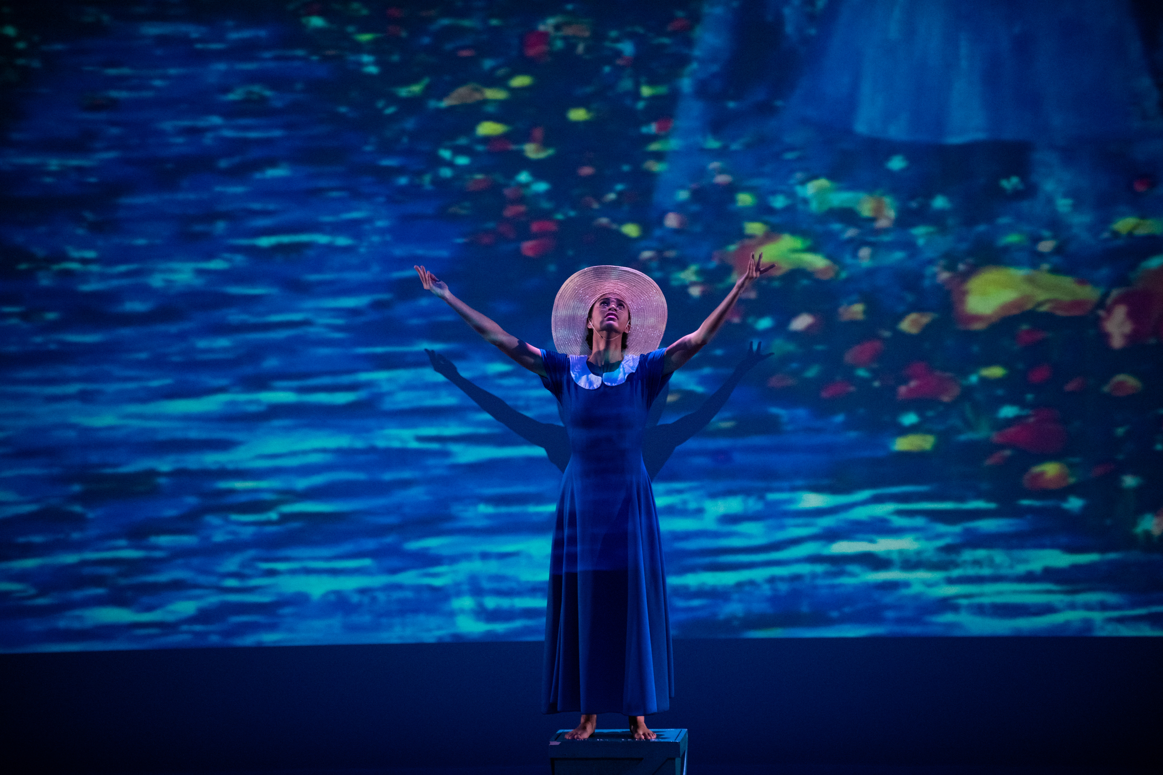
Workshop 2: A Pathway to Understanding and Healing: Exclusivity and Racism in Dance August 13, 2020
20XX
Attendees will write/dance their stories – Empathize with being an “other”

Slide 7
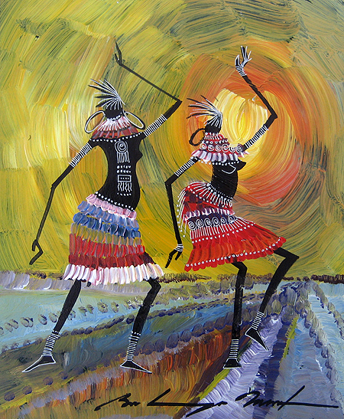
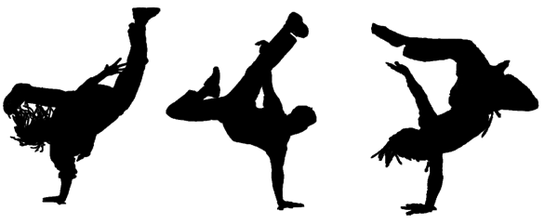
This Photo by Unknown Author is licensed under CC BY
This Photo by Unknown Author is licensed under CC BY-NC
This Photo by Unknown Author is licensed under CC BY
This Photo by Unknown Author is licensed under CC BY-SA
Workshop 3: Taking it to the Next Level: Jazz Dance for the Curious Dance Teacher August 20, 2020

Slide 8
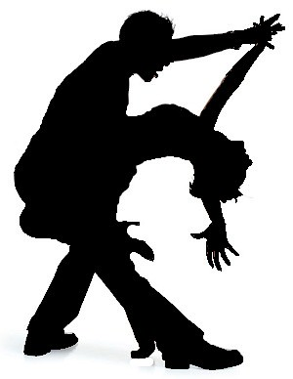
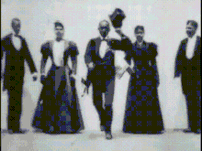
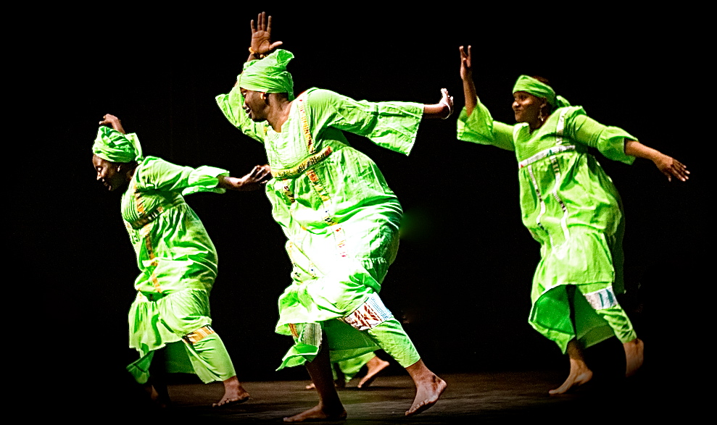
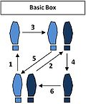
This Photo by Unknown Author is licensed under CC BY-SA
This Photo by Unknown Author is licensed under CC BY-SA
This Photo by Unknown Author is licensed under CC BY-NC-ND
This Photo by Unknown Author is licensed under CC BY-SA
This Photo by Unknown Author is licensed under CC BY-NC
Workshop 4: Ballroom Dance: A Lens for Discovering and Honoring our African Roots August 27, 2020

Slide 9
Solos @ Home Project
Create a solo based on one of the topics included in the workshop series.
For example, a solo could be based on a personal story.
Time limit – 2 minutes – no lyrics (spoken word acceptable)
Criteria:
1. Connection to the content of the webinars
2. Clear interpretation of a theme
3. Composition - elements
Submissions Due - 10/20/2020
$10 fee
First, Second and Third place Winners
· Registration information forthcoming
· Donations are welcome

Slide 10
Recognizing Systematic Racism in Dance Seattledance.com
Beliefs
Ballet is the foundation of all dance
Assuming all dancers can afford classes, have access to transportation and purchase tickets to performances
Assuming that all POC are more interested in hip hop, than modern or ballet
Teaching Practices
Requiring Black and Brown girls to wear pink tights and pink ballet shoes
Not including the cultural context of Ballet as an ethnic/folk dance
Making ballet and modern dance requirements for a dance degree but making jazz and hip hop electives
Valuing lines over rhythm , poise over grit, abstraction over substance.
Not teaching about the history of jazz and tap dance coming from the Black community

Slide 11
Questions to Discuss via Poll and Small Groups
How can you give students opportunities to think about their own racial and ethnic identities?
Do you employ creative dance techniques to have students embody social issues, such as racism, sexism etc? Please explain
Do you provide students with the history and contributions of African Americans to jazz, hip-hop and tap dance? Please explain
When teaching dance do you make connections between the dance form (ballet, modern, etc) and the cultural contexts? Please explain

Slide 12
Not everything that is faced can be changed, but nothing can be changed until it is faced” James Baldwin

Slide 13
Thanks!!!
Delaware Dance Education Organization in Collaboration with the Partnership for Arts & Culture

