Slide 1
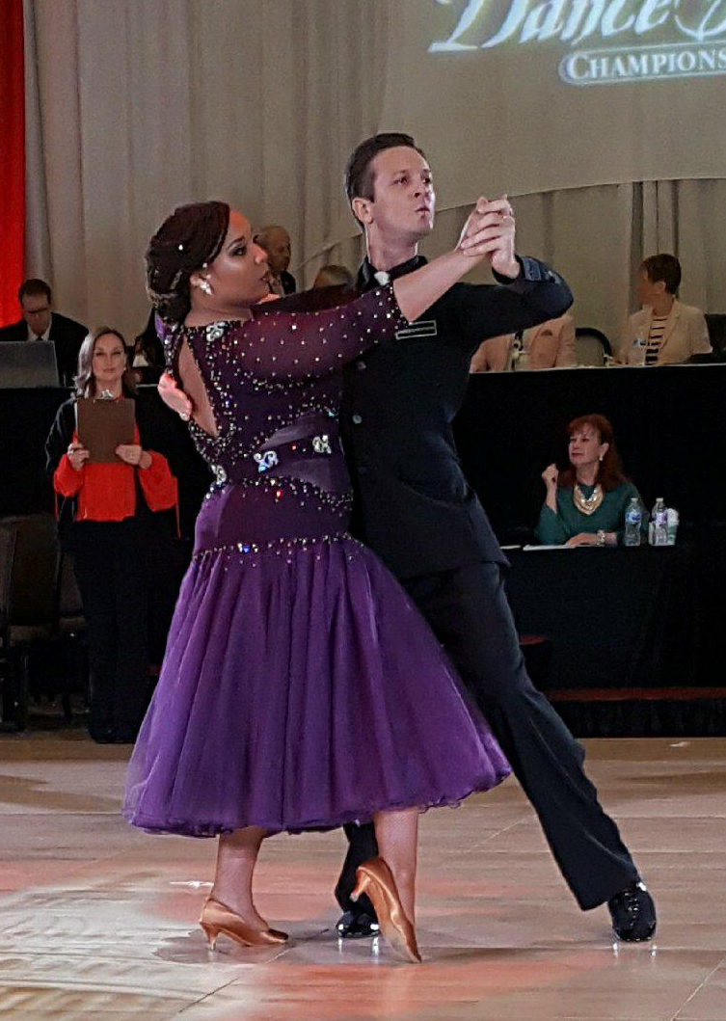
Groundswell: Dance as a force for social change
Workshop 4
Ballroom Dance: A Lens for Discovering and Honoring our African Roots
Presenters:
Ken Richards and Gabby Williams
As Ballroom Dance Educators, we took a deep look at the development of dances that are linked to circumstances of African enslavement and culture.

Slide 2
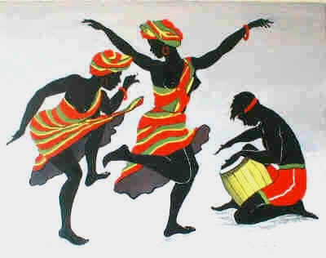
Groundswell: Dance as a force for social change
In the presentation today, through the lens of Ballroom Dancing, our goals include a focus on three areas:
dancing to preserve our history;
dancing to honor our ancestors and crush racial stereotypes and
dancing to claim our heritage and embrace other cultures.

Slide 3
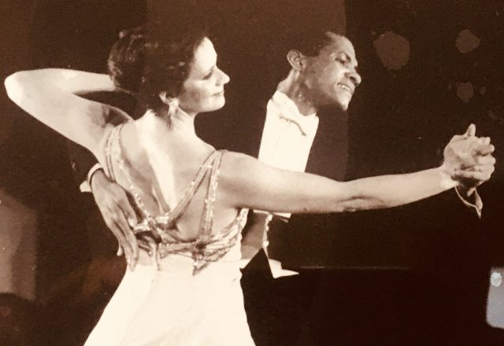
Groundswell: Dance as a force for social change
First – a Quick – Intro to Ballroom Dance?
Perhaps it would be better to think of ballroom dancing as partnership dancing that is practiced Socially and Competitively
The Dances range from the Smooth & Standard Dances – Waltz, Foxtrot, Tango, Viennese Waltz & Quickstep

Slide 4
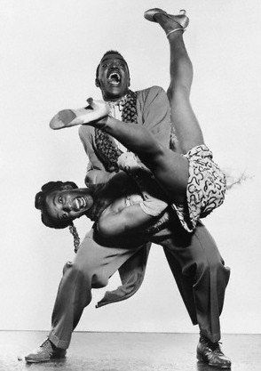
Groundswell: Dance as a force for social change
What is Ballroom Dance?
To the Rhythm and Latin Dances – Rumba, ChaCha, Jive, Paso Doble, Samba, Mambo, Bolero, West & East Coast Swing
To the Club Dances – Salsa, Bachata, Hustle, Merengue, Two-Step
And a host of Fun/Misc. Dances like Polka, Lindy Hop and Charleston

Slide 5
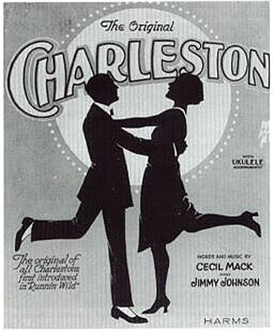
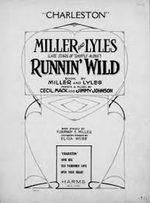
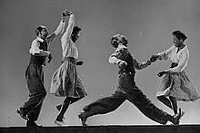
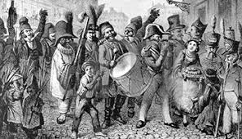
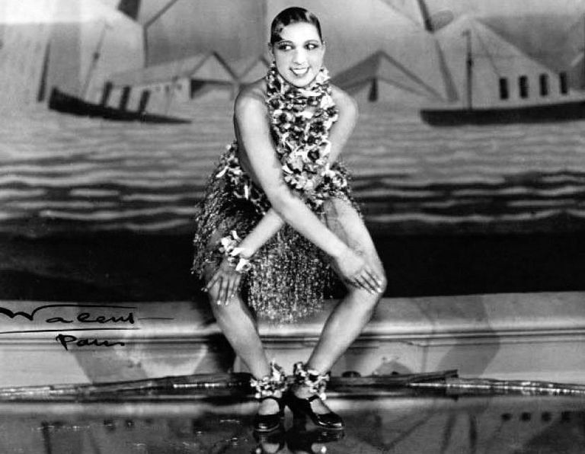
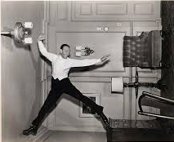
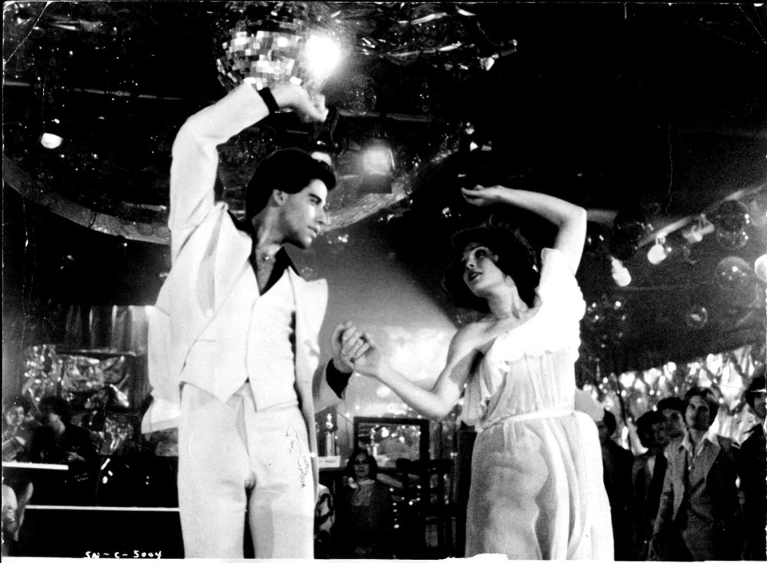
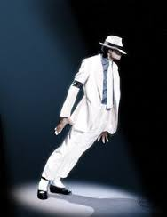
Groundswell: Dance as a force for social change
1700
1800
1900
2000

Slide 6
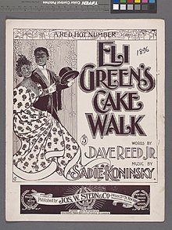
Groundswell: Dance as a force for social change
Where did all these dances come from?
All have their roots in a particular time, place and circumstance.
For example, in the United States, when the drums were banished, the enslaved began dancing to the fiddle, banjo and tambourine, the dance – the Cakewalk became a dance for entertainment, rather than a part of life as it had been in Africa.

Slide 7
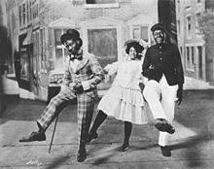
Groundswell: Dance as a force for social change
The Past…
Cake Walk – drums, no drums
The Cake Walk was a pre-Civil War dance originally performed by slaves on plantation grounds. The American dance was first known as the "prize walk"; the prize was an elaborately decorated cake.

Slide 8
Groundswell: Dance as a force for social change
The Cakewalk
https://www.youtube.com/watch?v=BkXQX1C9VWo

Slide 9
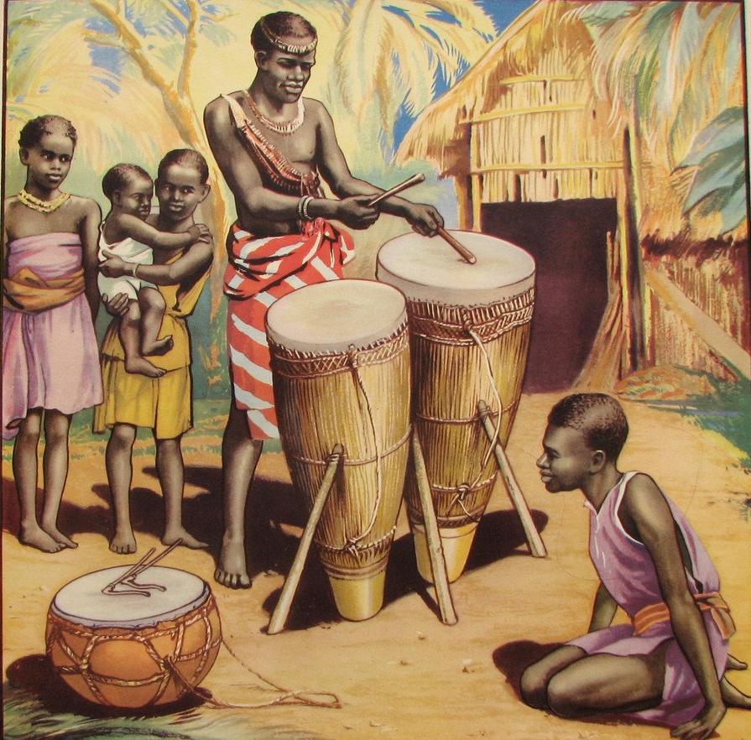
Groundswell: Dance as a force for social change
Where did all these dances come from?
In other parts of the world… such as, The Caribbean and South America… where the drums were not prohibited, dances such as the Samba, Mambo, and Rumba can be directly linked to African heritage.

Slide 10
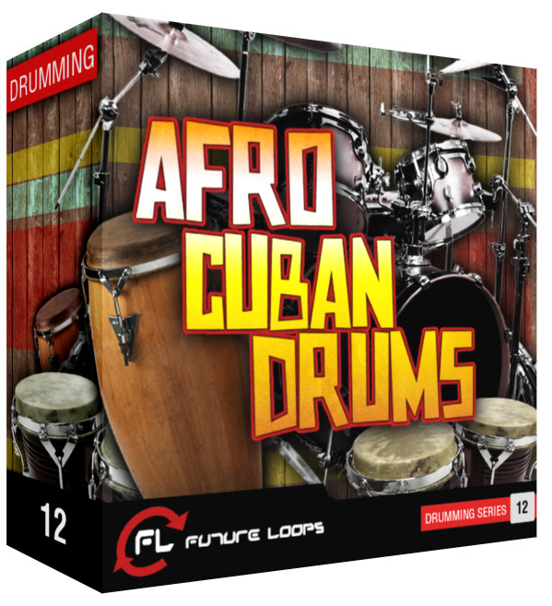
Groundswell: Dance as a force for social change
The Afro-Cuban ”son” is rich with religious rituals and sensual dances, and there is a rich history behind its rhythm Son music has roots in Yoruban sacred music which originates from Nigeria.
African based religions arrived in Cuba around the late 1500s during the inception of slavery (Hodges 35; Leymarie 10). Its folkloric tradition is surrounded by mysterious rituals, burnt offerings and animal sacrifices to the Gods.
The slaves did not relinquish their culture; they substituted the names of their African gods with the names of the Catholic saints.
- Inquiries Journal of Social Sciences Ars & Humanities 2015 Vol 7 No. 10

Slide 11
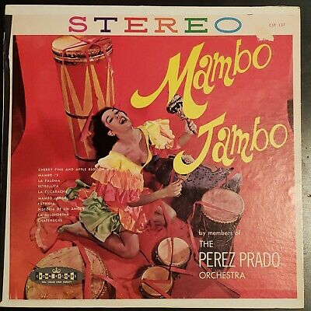
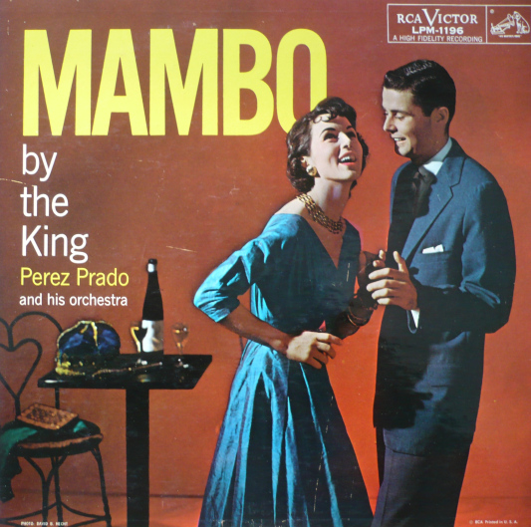
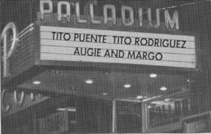
Groundswell: Dance as a force for social change
The Mambo – from the streets of Cuba to Ballrooms of New York

Slide 12
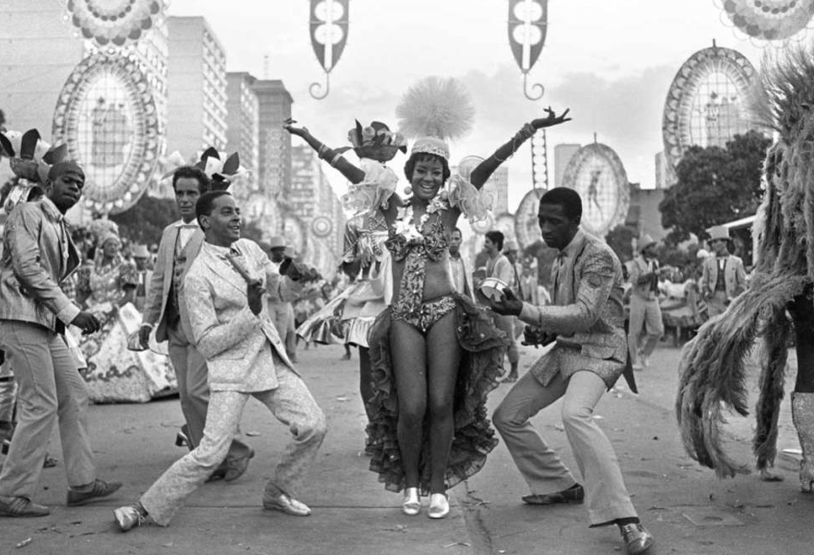
Groundswell: Dance as a force for social change
The carnival is said to be the result of a cultural clash of Portuguese and African culture, starting with the Portuguese bringing the festival (Entrudo) with them from Europe after colonizing Brazil in the early 17th century.
Grand balls and parties were held only for the elite Portuguese, but soon, Afro-Brazilians decided to hold parties of their own, playing African-inspired music and wearing fancy dress to mock the formal dress of the elite.
The two celebrations stayed separate for many years until the turn of the 20th century when the parties took to the streets. The festival was now an annual party, with musical styles and dancing merging over time. In 1917, this traditional dancing and music style was officially coined ‘samba’ and has been a core part of Brazil’s musical heritage ever since.

Slide 13
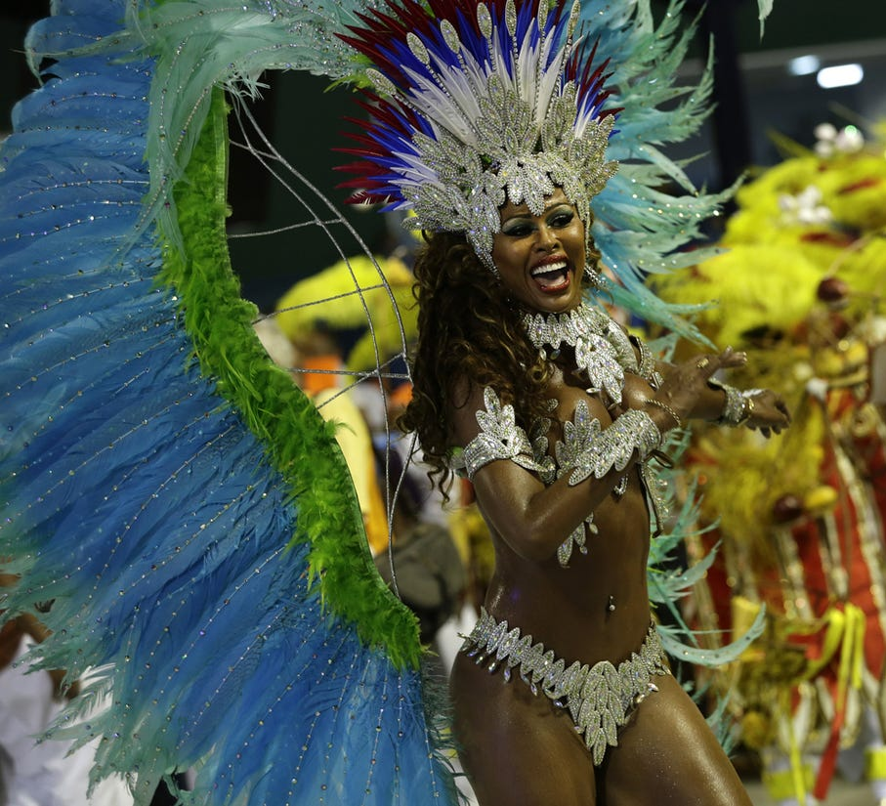
Groundswell: Dance as a force for social change
Dance Time
EVERYBODY UP – Let’s Samba... And learn the Batucada
Brazilian Carnival Drums

Slide 14
Groundswell: Dance as a force for social change
Samba Performance from 2014 by Motsi and Partner

Slide 15
Groundswell: Dance as a force for social change

Slide 16
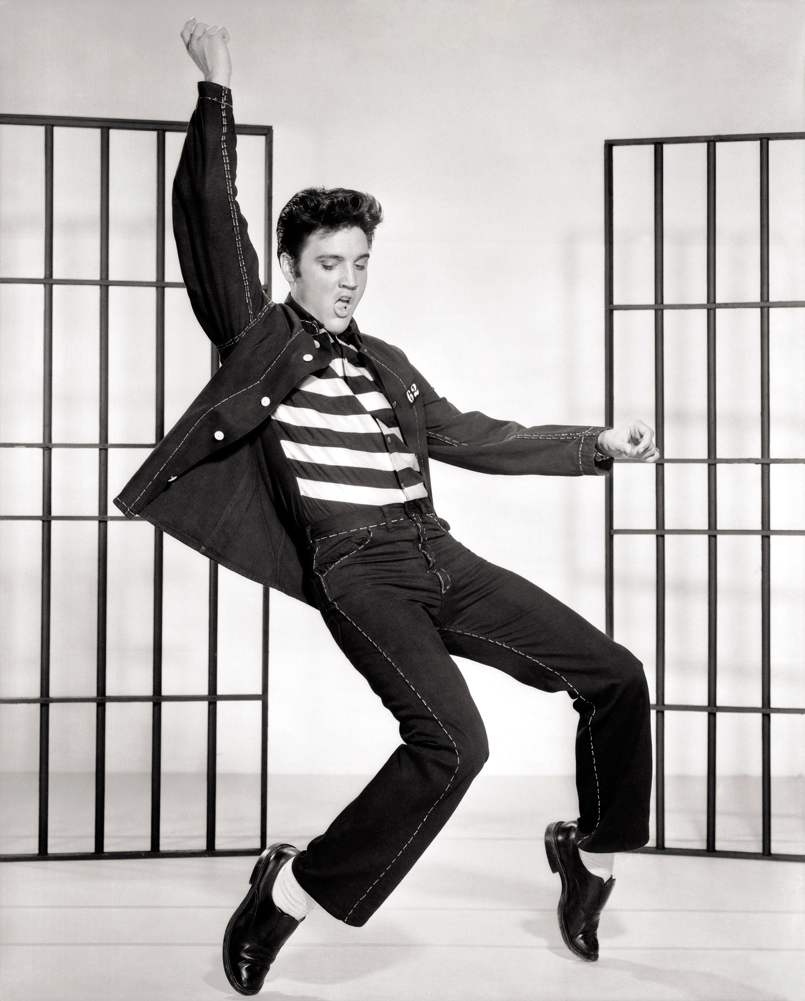
Groundswell: Dance as a force for social change
The Past…
Where did the music go?
Did Hollywood and the Media “Take Away The Drums” again?
Did the “King of Rock and Roll” invent a new genre or was he influenced by his roots?

Slide 17
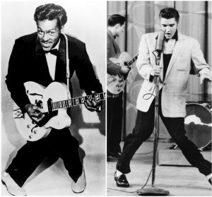
Groundswell: Dance as a force for social change
Chuck Berry / Elvis / Little Walter
Elvis Presley was always drawn to Chuck Berry's music. Elvis began singing Chuck Berry songs when his career was just starting to get on track back in 1955. Chuck Berry also wrote songs for Little Walter, which Elvis Later duplicated.

Slide 18
Groundswell: Dance as a force for social change
Chuck Berry and Elvis Presley - Johnny B. Goode

Slide 19
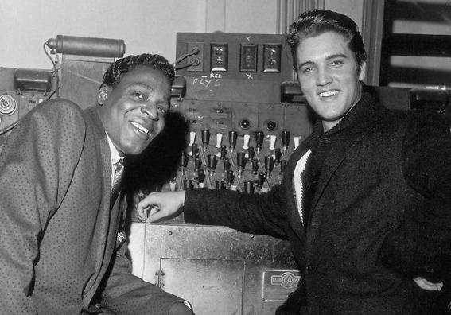
Groundswell: Dance as a force for social change
Elvis in an interview with Jet Magazine states: "The coloured folks been singing it and playing it just like I'm doing now, man, for more years than I know," Elvis said. "I got it from them. Down in Tupelo, Mississippi, I used to hear old Arthur Crudup bang his box the way I do now, and I said if I ever got to the place where I could feel all old Arthur felt, I'd be a music man like nobody ever saw.“ Learn more… Read the full story – “The Black Artist That Inspired Elvis Presley” May 31, 2018

Slide 20
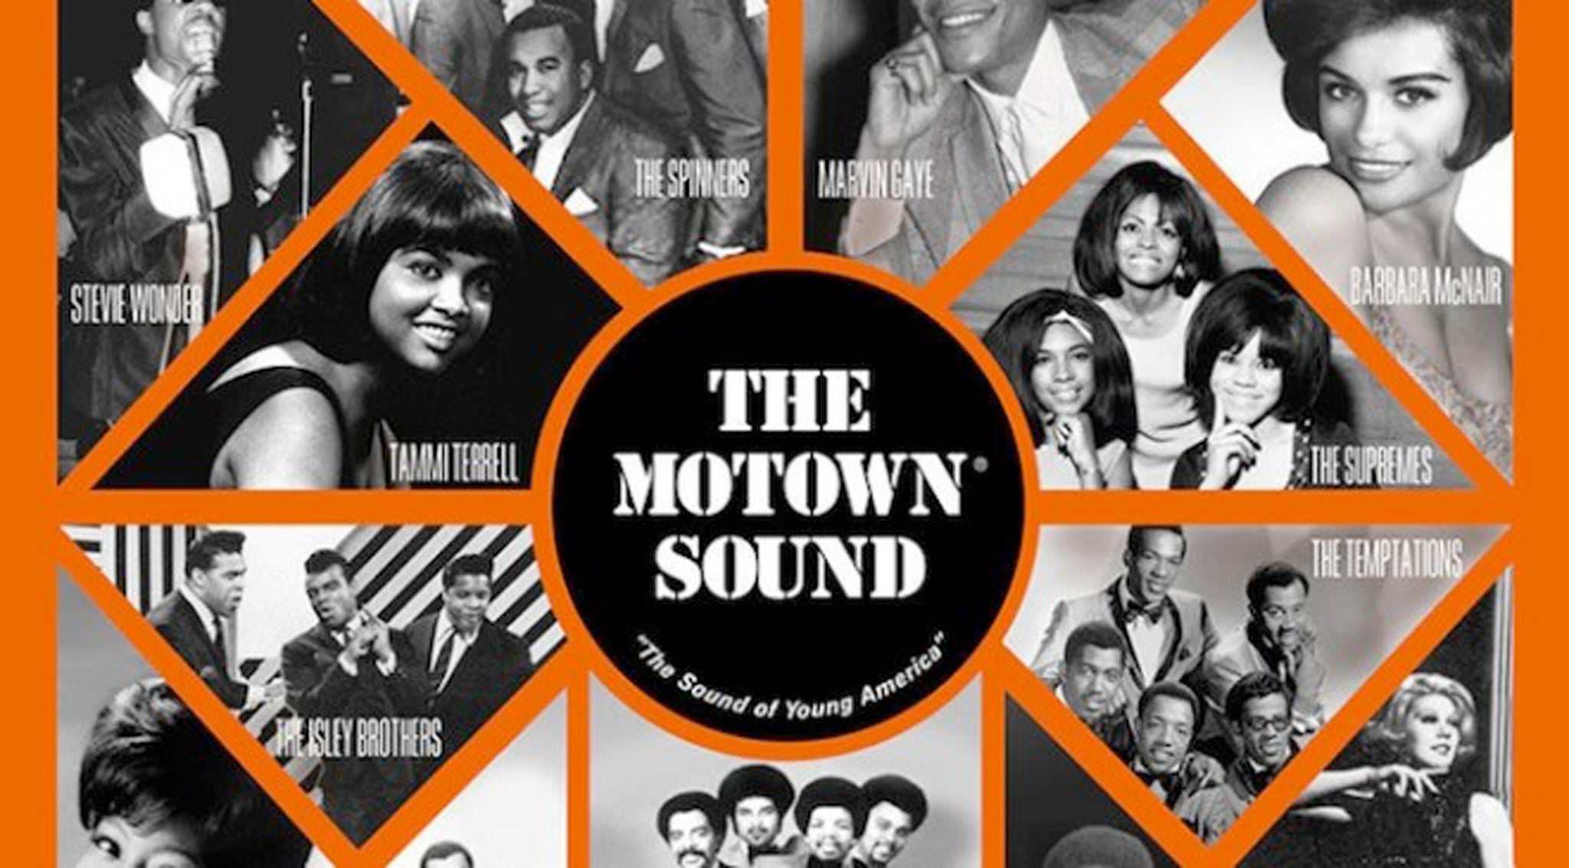
Groundswell: Dance as a force for social change

Slide 21
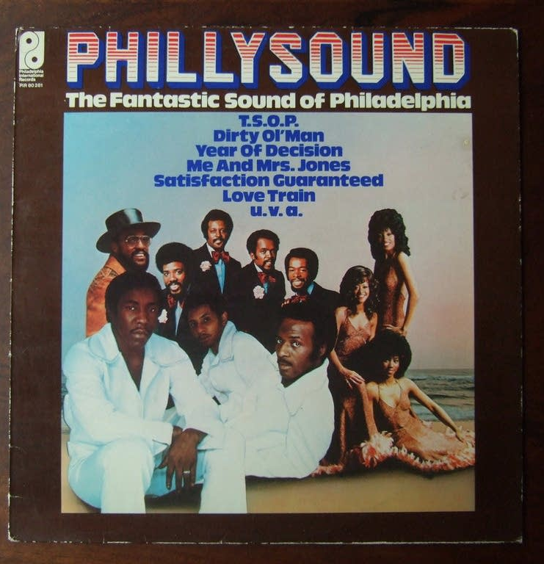
Groundswell: Dance as a force for social change

Slide 22
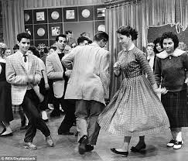
Groundswell: Dance as a force for social change
Hiding In Plain Sight
For many Years American Bandstand banned Black performers and audience members.
Previous audience member Donald Morgan, often danced in the audience with his dance partner, both passing for white in the late 50’s.
“They didn’t allow you in unless you were white and that was a fact, but they didn’t know who we where.”
AB 1957 Philadelphia

Slide 23
Groundswell: Dance as a force for social change
American Bandstand 1957 Philadelphia

Slide 24
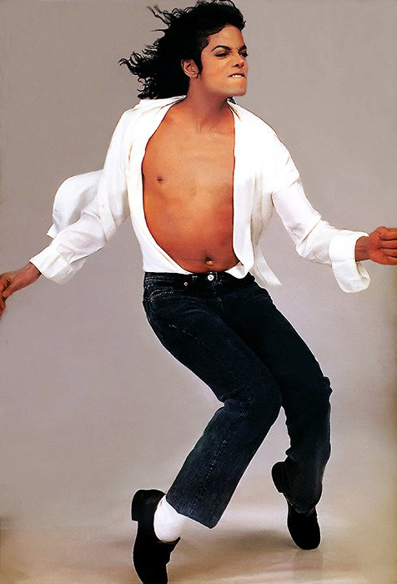
Groundswell: Dance as a force for social change
Influence… Evolution… Creativity…
Motown gave us the Jackson 5 and the New KING… The King of Pop.
Who continued to influence the way we danced even in the ballroom – everyone was working the Robot and Moon Walk Into their Choreography.

Slide 25
Groundswell: Dance as a force for social change
The Past… Huh?
Influence Goes Two Ways… And just maybe there was a different origin for the famous Moon Walk too. Let’s Take A Look…

Slide 26
Groundswell: Dance as a force for social change
Bill Bailey at the Apollo Theatre in 1955

Slide 27
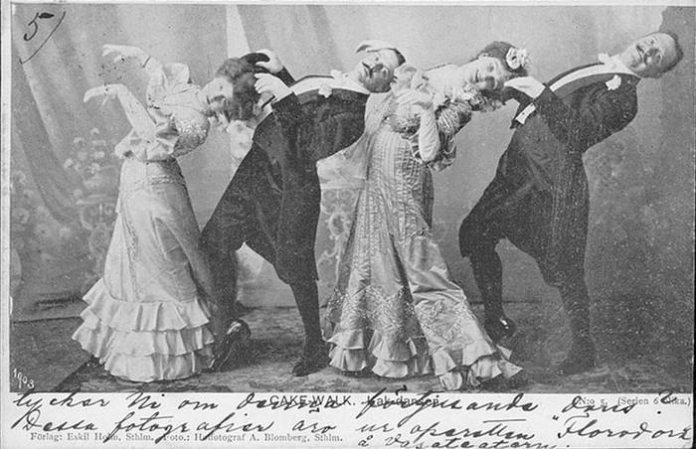
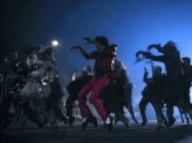
Groundswell: Dance as a force for social change
Beyonce Single Ladies 2008
Are famous dance hits as original as we think?
Madonna Girl Gone Wild 2012
Cakewalk Dance 1903
Thriller Music Video 1982

Slide 28
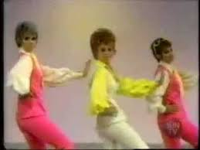
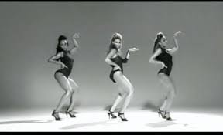
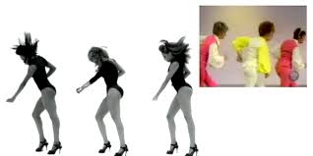
Groundswell: Dance as a force for social change
Are famous hits actually as original as we think?
Mexican Breakfast Dance 1969
Single Ladies Music Video 2008
Mexican Breakfast vs Single Ladies

Slide 29
Groundswell: Dance as a force for social change
Mexican Breakfast vs Single Ladies

Slide 30
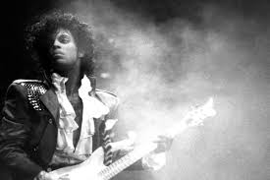
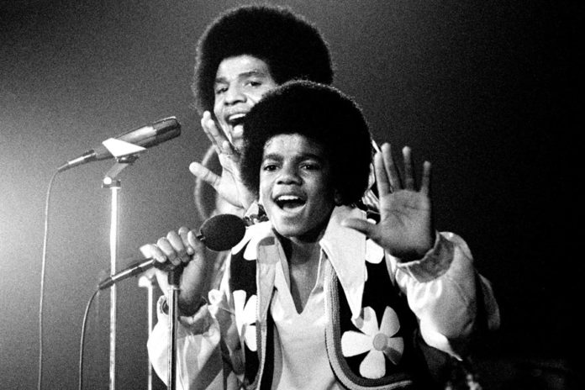
Groundswell: Dance as a force for social change
We influence, support and inspire one another through dance.
-We dance to preserve our history.
James Brown Moves

Slide 31
Groundswell: Dance as a force for social change
Why don’t we see a lot of competitive ballroom in the black communities?
The government is set up against our well-being. Many communities of color do not have the resources.
Communities of color need better:
Healthcare
Jobs
Role models
Education

Slide 32
Groundswell: Dance as a force for social change
Why don’t we see a lot of competitive ballroom in the black communities?
Cell Memory:
Our genetic and emotional link to our ancestors.
Do our cells categorize us by the color of our skin, or does our skin contain memories of dancing before our own existence?
It Didn’t Start With You
By
Mark Wolynn

Slide 33
Groundswell: Dance as a force for social change
Why don’t we see a lot of competitive ballroom in the black communities?
Do we feel at home home on every dancefloor?
Does the music remind us of more than we realize or remember?
How do we make you feel?
VS

Slide 34
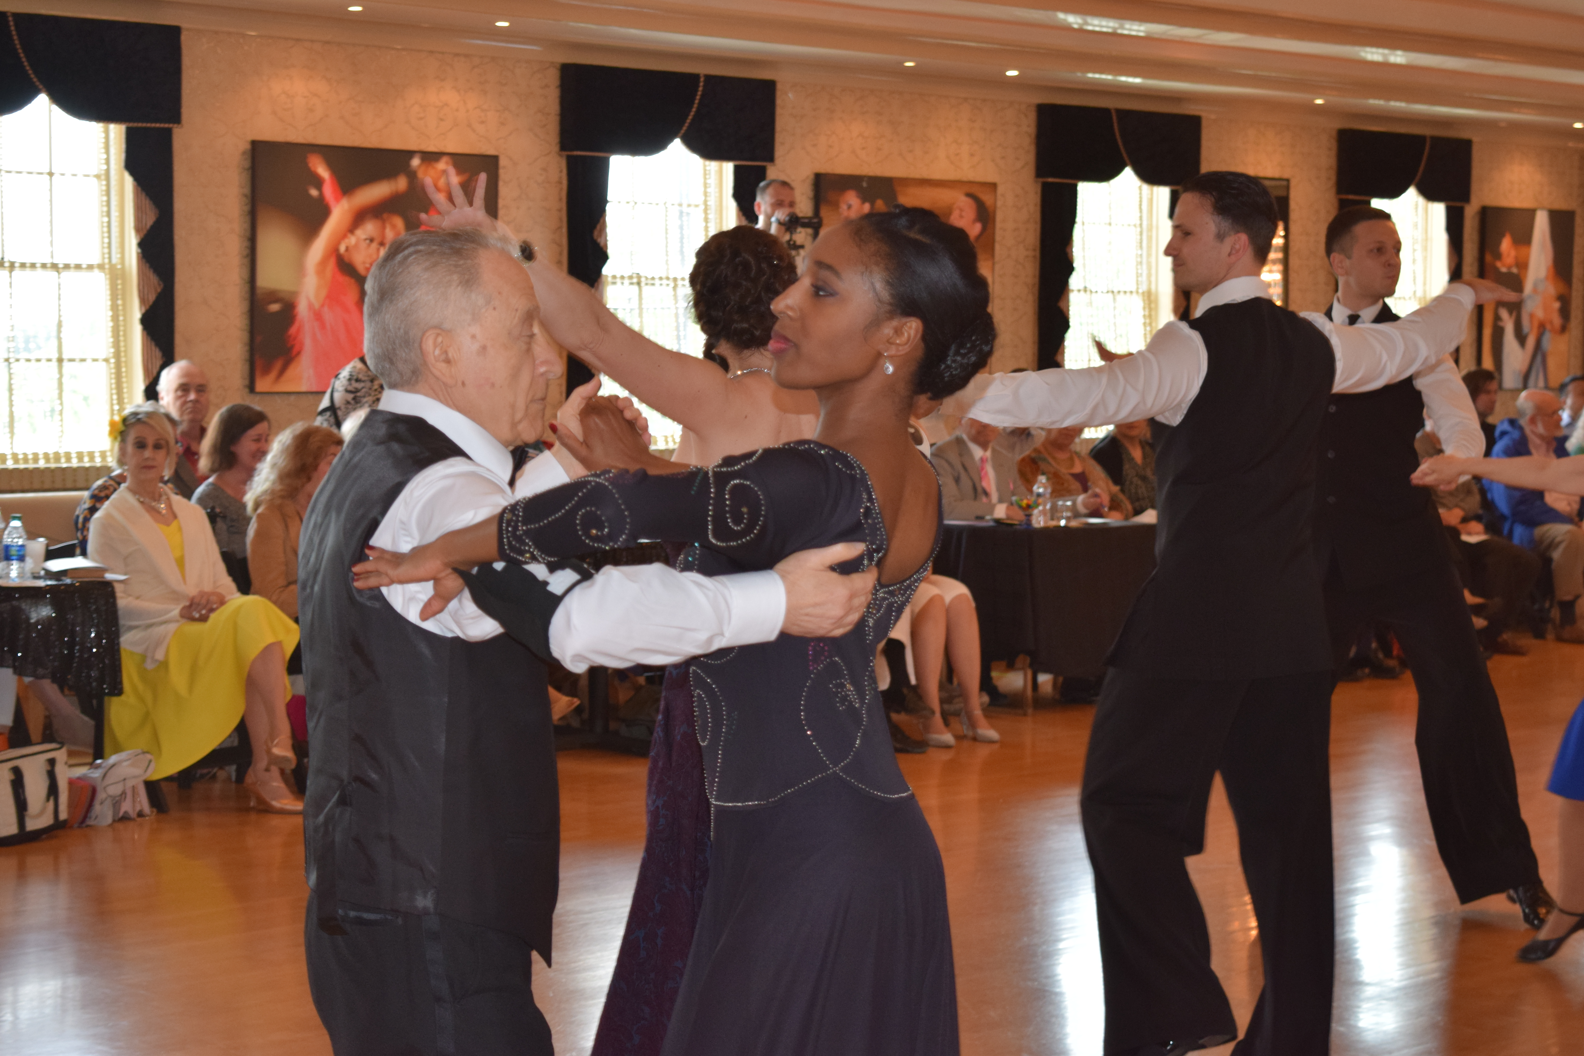
Groundswell: Dance as a force for social change
Does the music remind us of more than we realize or remember?
How does one dance style make you feel compared to another?
What music is your body naturally drawn to?
How can we better embrace different cultures on the dance floor?

Slide 35
Groundswell: Dance as a force for social change
The Ballroom style VS the Rhythm style
Is there really a difference?

Slide 36
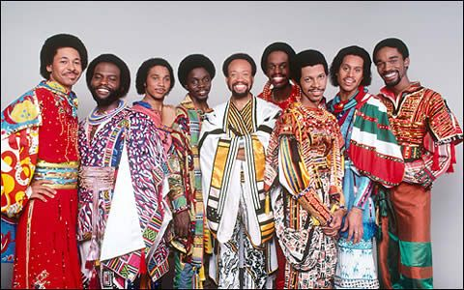
Groundswell: Dance as a force for social change
Earth Wind and Fire

Slide 37
Groundswell: Dance as a force for social change
How are cultures overshadowed or forgotten in our country?
How can we bring it back to the dance floor?
How can we educate ourselves to teach more authentically?
How can we educate this next generation to value and relate to other cultures?

Slide 38
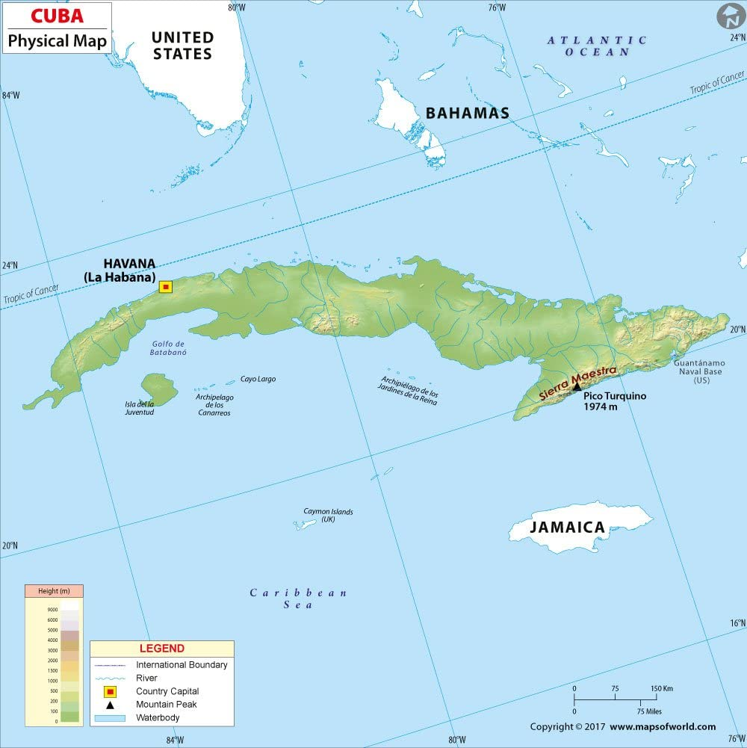
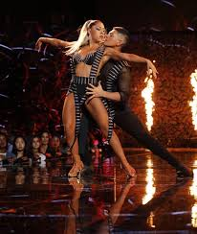
Groundswell: Dance as a force for social change
Afro Cuban Dance
Rumba
Cha Cha
Bolero
Mambo
Salsa
Jean Michel Professional Rhythm Champion - Rumba
Karen & Ricardo

Slide 39
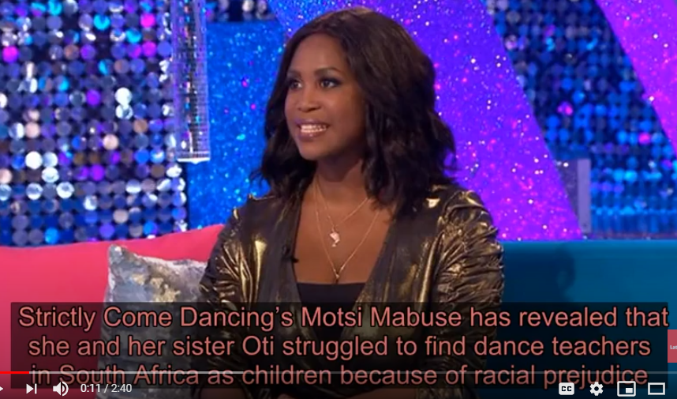
Groundswell: Dance as a force for social change
Overcoming Obstacles…
Motsi Mabuse of South Africa, Former Latin Dance Champion, Judge on Strictly Come Dancing – the German version of Dancing With The Stars

Slide 40
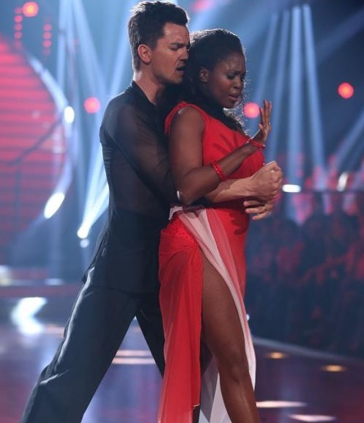
Groundswell: Dance as a force for social change
Motsi Mabuse goes on to say:
“finding people to give us the instruction was difficult in South Africa. To be a little girl and push yourself in this type of dancing, where there are no other black girls, was really tough.”

Slide 41
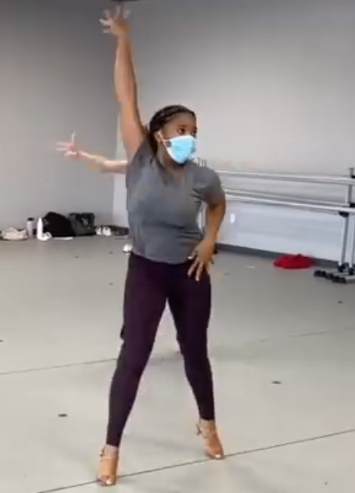
Groundswell: Dance as a force for social change
The future is on our hands…
Valentin Chmerkovskiy – excerpt of Facebook Post - August 11, 2020
“Representation is important. Growing up competing in Ballroom/Latin I rarely saw girls that looked like Ella Hendricks at competitions. I found it odd that folks whose history and culture was such a huge part of the influence, composition, and inspiration for most if not all of the Latin dances, were nowhere to be seen.”

Slide 42
Groundswell: Dance as a force for social change

Slide 43
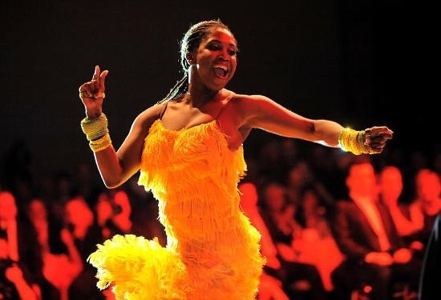
Groundswell: Dance as a force for social change
“Now there are many factors to take into account for this unfortunate phenomenon, but I’m looking ahead. I’m looking to see more Ellas embracing the style and taking it to the next level.
I want to shift the taboo and be a part of the wave that can hopefully inspire more black and brown kids to take up Ballroom and Latin dance. I hope girls like Ella can help shape the future of Ballroom/Latin dance. I hope we can keep breaking molds and continue to evolve our sport. That’s what makes this country amazing to me, our flag doesn’t belong to anyone, it belongs to everyone willing to wave it proudly.”

Slide 44
Solos @ Home Project
Create a solo based on one of the topics included in the workshop series.
For example, a solo could be based on a personal story.
Time limit – 2 minutes – no lyrics (spoken word acceptable)
Criteria:
1. Connection to the content of the webinars
2. Clear interpretation of a theme
3. Composition - elements
Submissions Due - 10/20/2020 via YouTube or Vimeo link to ddeo.board@gmail.com
Submission Fee - $10 paid to https://givebutter.com/YvTqTg
Virtual Showcase – 11/12/2020
First, Second and Third place Winners
More information to come.

